Slide 1



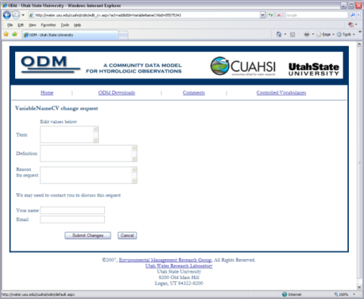
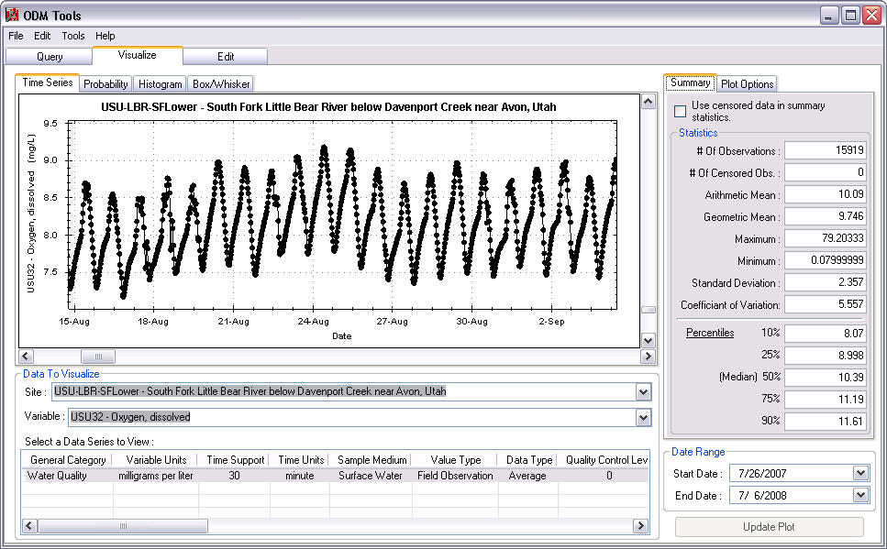

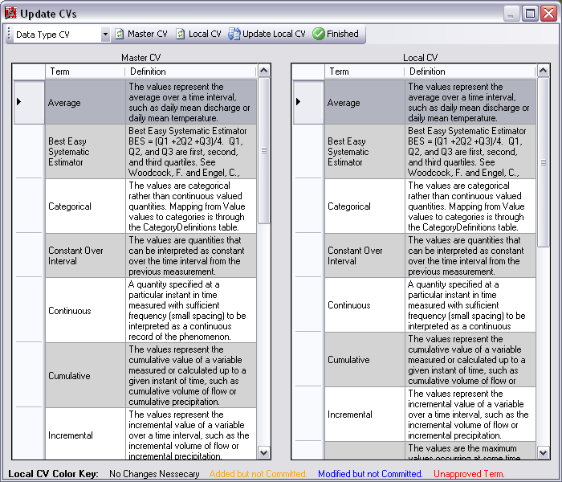

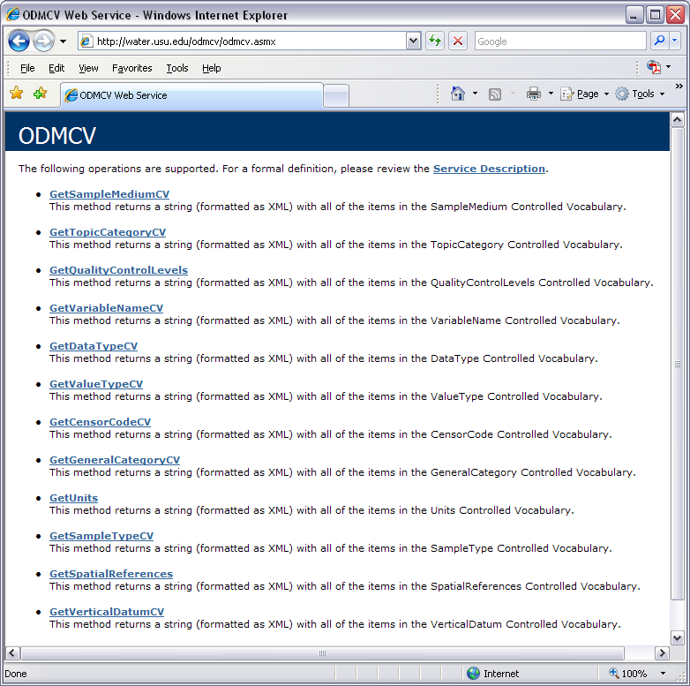
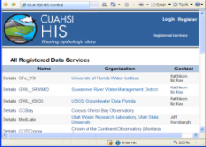
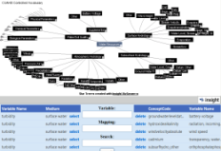
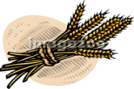

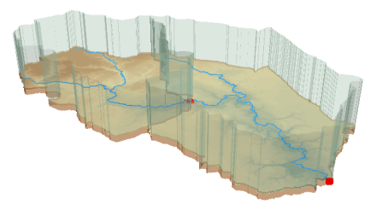
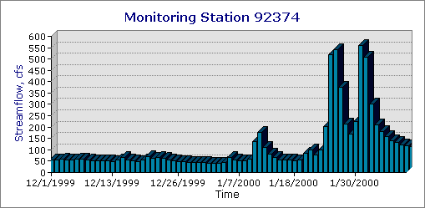
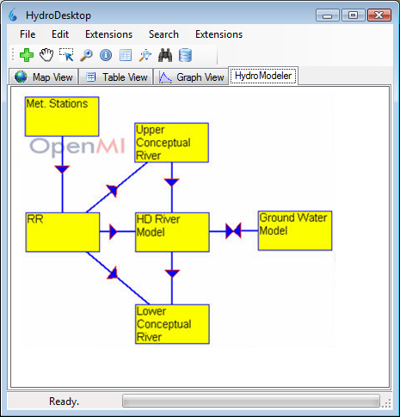
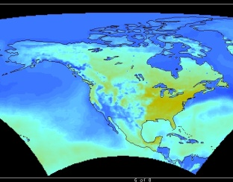
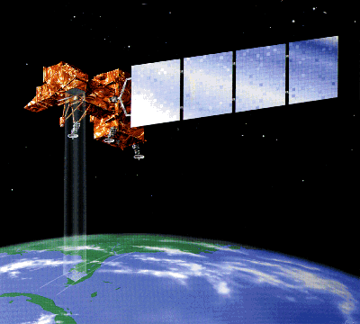
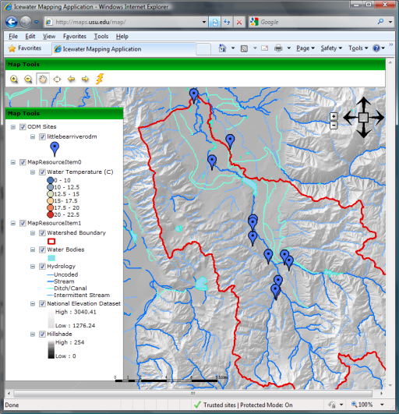
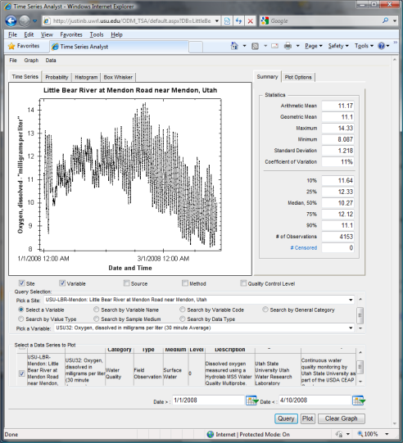
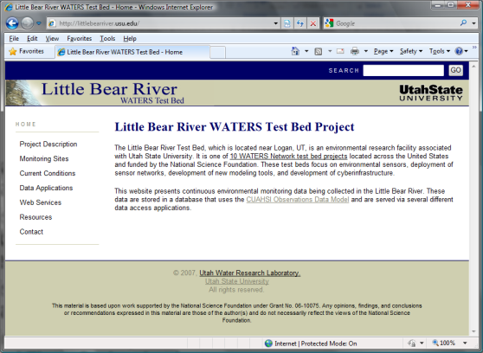
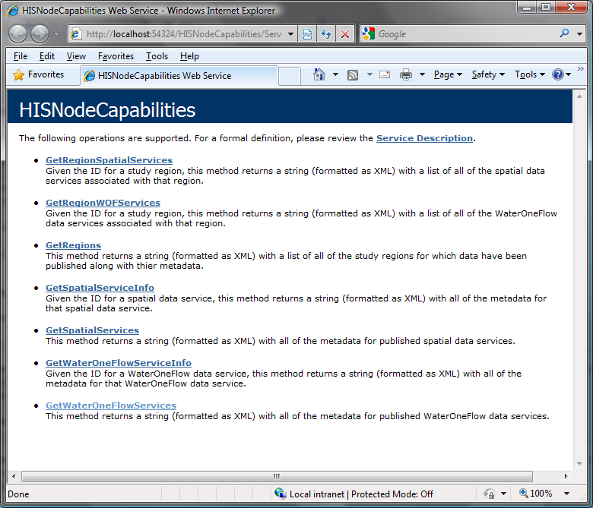
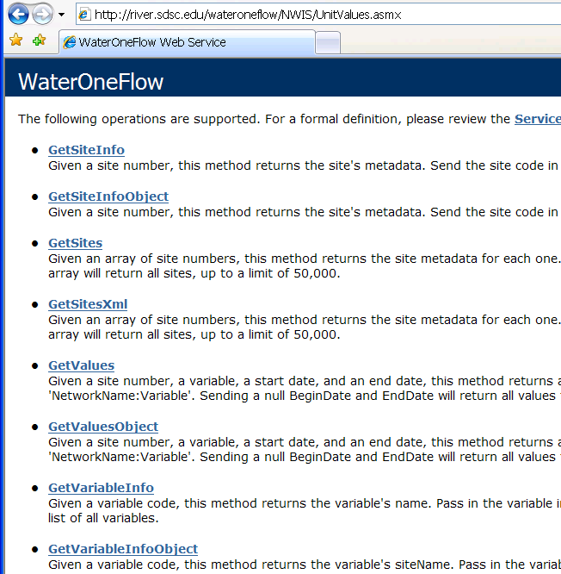
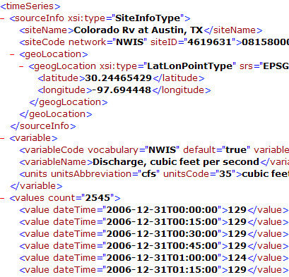
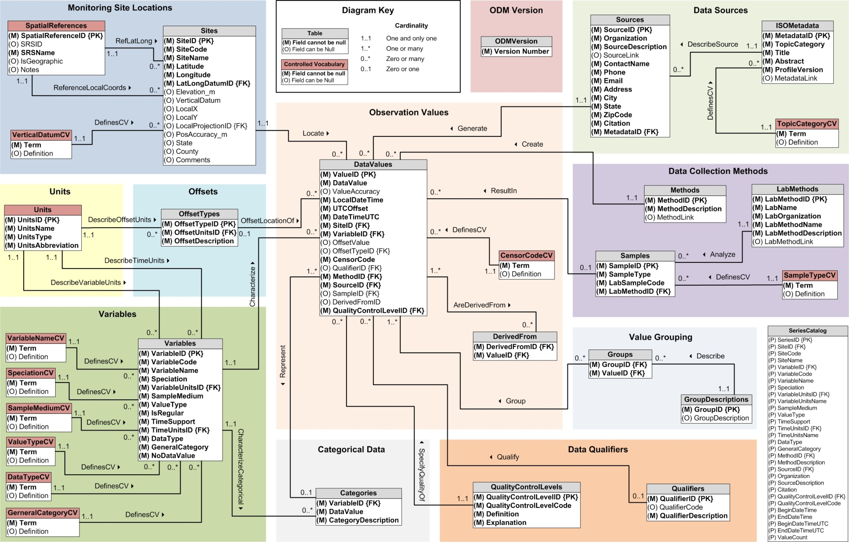
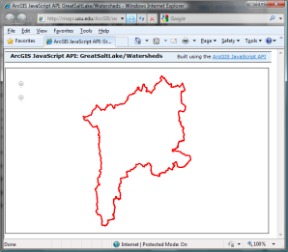
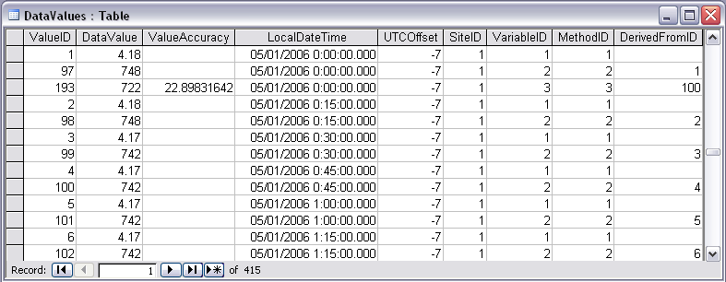
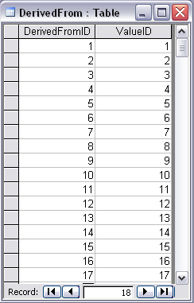
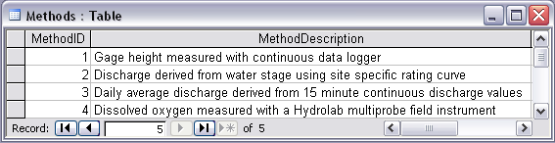
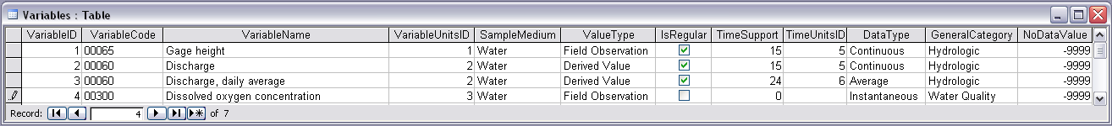
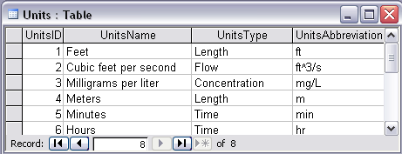
Sharing Hydrologic Data with the CUAHSI* Hydrologic Information System
H51H-0854
David G. Tarboton¹, David R. Maidment², Ilya Zaslavsky³, Jeffery S. Horsburgh¹, Tim Whiteaker², Michael Piasecki⁴, Jonathan L Goodall⁵, David Valentine³, Thomas Whitenack³
Utah Water Research Laboratory, Utah State University, Logan, Utah, USA; 2. Center for Research in Water Resources, University of Texas at Austin, Austin, Texas, USA; 3. San Diego Supercomputer Center, University of California at San Diego, San Diego, California, USA; 4. Department of Civil, Architectural, and Environmental Engineering, Drexel University, Philadelphia, Pennsylvania, USA; 5. Department of Civil and Environmental Engineering, University of South Carolina, Columbia, South Carolina, USA.
http://his.cuahsi.org
This work was funded by the U.S. National Science Foundation under grant EAR 0622374. Any opinions, findings and conclusions or recommendations expressed in this material are those of the authors and do not necessarily reflect the views of the National Science Foundation.
CUAHSI Water Data Services System Components
Overview
1
Reducing Semantic Heterogeneity
The CUAHSI Hydrologic Information System (HIS) is an internet based system to support the sharing of hydrologic data. It is comprised of hydrologic databases and servers connected through web services as well as software for data publication, discovery and access.
Dynamic controlled vocabulary moderation system
Platform independent Analysis
Discovery and Access
Service Oriented Architecture
ODM Data Manager
ODM Website
Query, Visualize, and Edit data using ODM Tools
Hydro
Desktop
HydroExcel
Data Discovery and Integration platform
GIS
Matlab
Splus
R
IDL
Java
C++
VB
1
HIS Central
Like search portals Google, Yahoo, Bing
ODM
Tools
XML
ODM Controlled
Vocabulary Moderator
1
Metadata Services
Metadata Search
Local ODM
Database
ODM
Controlled Vocabulary
Web Services
Master ODM Controlled Vocabulary
Service registration
Service and data theme metadata
Streaming Data Loader
ODM
Database
WaterML
Service Registry
2
Catalog harvesting
3
Data carts
4
HIS
Server
Base Station
Computer(s)
GetSites
GetSiteInfo
GetVariableInfo
GetValues
Data Publication platform
Data Services
Data Synthesis and Research platform
http://his.cuahsi.org/mastercvreg.html
Excel, text
USGS NWIS
Harvester
HIS Central
HIS Server
Water Data Services
HydroDesktop
HydroDesktop
Telemetry Network
ODM Data Loader
WaterOneFlow
Web Service
Water Metadata Catalog
Spatial Data Services
4
Like web servers
Like HTML
Like browsers
Observations
Platform for data discovery, access, integration and analysis
Uses MapWindow 6 open source GIS software development toolkit
Plug-in architecture
Data abstraction layer
http://hydrodesktop.codeplex.com open source software development portal
Windows and Mac compatible (through Mono)
EPA STORET
NCDC
Others
HIS Server is a repository of hydrologic time series data published as WaterOneFlow web services
HIS Central is a metadata catalog of data accessible through WaterOneFlow web services
Hydro Desktop accesses hydrologic data discovered on HIS Central and acquired from HIS Servers
GIS
Models
Sensors
HIS Server
The three components function for hydrologic information analogously to the internet as a whole comprised of web servers, browsers, and search portals interacting using HTML for text and images
Climate
Remote Sensing
2
You can participate through establishing a HIS Server to organize and share your data, discovering and accessing data through HydroDesktop and contributing to the open source system development. See http://his.cuahsi.org and http://www.hydrodesktop.org.
Map Server
Time Series Analyst
HIS Server Website
HIS Server Capabilities Web Service
2
Observations Data Model (ODM)
3
WaterML and WaterOneFlow
What are the basic attributes to be associated with each single data value and how can these best be organized?
Query functions
Return data in WaterML
WaterML is an XML language for communicating water data
WaterOneFlow is a set of web services based on WaterML
OGC process for worldwide standardization
Some adoption by USGS and NCDC
HIS Server Database Configuration Tool
Precipitation
& Climate
Streamflow
Groundwater
levels
WaterOneFlow
Services
HIS Server
Database
Spatial
Services
Soil
moisture
data
Water Quality
Flux tower
data
A relational database at the single observation level (atomic model)
Stores observation data made at points
Metadata for unambiguous interpretation
Traceable heritage from raw measurements to usable information
Standard format for data sharing
Cross dimension retrieval and analysis
WaterOneFlow
WaterOneFlow
WaterOneFlow
ODM
ODM
ODM
Summary
ODM Databases and WaterOneFlow Web Services
ArcGIS Server Spatial Data Services
Stage and Streamflow in ODM Example
The CUAHSI Hydrologic Information System provides
Data Storage in an Observations Data Model (ODM) on an HIS Server
Data Delivery through internet-based Water Data Services using a consistent data language, called WaterML
Data Discovery through federated thematic keyword search services and a National Water Metadata Catalog
Data Access and Analysis through a Client Application (HydroDesktop)
HIS Server is comprised of a collection of datasets, web services, tools, and software applications that allow data producers to store, publish, and analyze space-time hydrologic datasets
Designed to permit local control of the data, while still being part of a distributed, national/international system allowing universal access to the data
Enables producers of hydrologic data to join a growing, distributed network of published hydrologic data services
Tools for local management of data on the server, as well as a set of Internet-based applications for accessing, visualizing, and downloading hydrologic data
Horsburgh, J. S., D. G. Tarboton, D. R. Maidment and I. Zaslavsky, (2008), A Relational Model for Environmental and Water Resources Data, Water Resour. Res., 44: W05406, doi:10.1029/2007WR006392.
* CUAHSI is the Consortium of Universities for Hydrologic Sciences, Inc. a consortium of 133 University and research organizations with support from the U.S. National Science Foundation to develop infrastructure for hydrologic science research. See http://www.cuahsi.org.

