Slide 1


The Identification and Mapping of Flow Networks from Digital Elevation Data
David G. Tarboton
Utah State University
Ude Shankar
NIWA, New Zealand

Slide 2
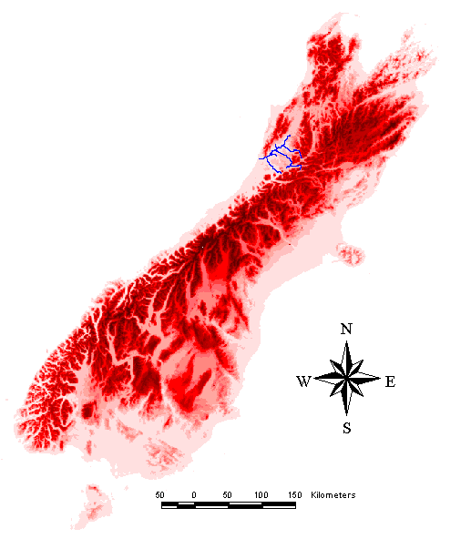
Location Map of the Grey River
New Zealand South Island
Basin Area: 3817 km²
Flow: 12.1 x 10⁹ m³
Flow/Area: 3184 mm
Greymouth
Christchurch

Slide 3
Grey Digital Elevation Model
2815 rows
3675 columns
30 m grid
Notes:
The source data is 20 m contours digitized from 1:50,000 scale topographic maps. This has been processed into a 30 m grid using TOPOGRID, the Arc/Info grid implementation of Hutchinson’s ANUDEM methods for gridding contour data while respecting topographic drainage features.
The Grey river is located on the West Coast of the South Island of New Zealand. The range to the NW is the Paparoa going up to 1400 m, with an extension of the Southern Alps to the south and east going up to 1950 m within the area shown. The presence of the central fault is clearly evident. The orography has a big influence on precipitation. Valley annual rainfall totals are 2 m or even lower in the rain shadow of the Paparoa’s. Mountain annual rainfall totals of 5m have been recorded, but gauges are sparse in the mountains.

Slide 6
Contrasting Interpretations
“landscape dissection into distinct valleys is limited by a threshold of channelization that sets a finite scale to the landscape.” (Montgomery and Dietrich, 1992, Science, vol. 255 p. 826.)
“any definition of a finite channel network is arbitrary, and entirely scale dependent.” (Band, 1993, in “Channel Network Hydrology”, edited by Beven and Kirkby, p15.)

Slide 7
Grid Based DEM Analysis Methods
Pit Filling (standard flooding approach)
Flow directions
  D8 (standard)
  D∞ (Tarboton, 1997, WRR 33(2):309)
  Flat routing (Garbrecht and Martz, 1997, JOH 193:204)
Contributing area calculation (standard, adapted for D∞)
Local curvature computation (Peuker and Douglas, 1975, Comput. Graphics Image Proc. 4:375)
Source Identification
  Support area threshold/channel maintenance coefficient (Standard)
  combined area-slope threshold (Montgomery and Dietrich, 1992, Science, 255:826)
  local curvature based (advocated here)
Threshold/drainage density selection
  Slope-area breakpoint
  Constant stream drop statistical test (Tarboton et al., 1991, Hyd. Proc. 5(1):81)

Slide 8
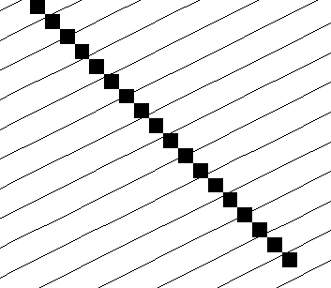
D8

Slide 9

D∞

Slide 11
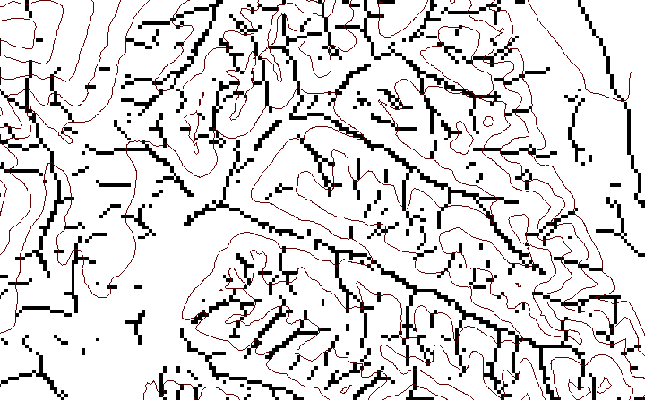
Local Curvature Computation
(Peuker and Douglas, 1975, Comput. Graphics Image Proc. 4:375)
43
48
48
51
51
56
41
47
47
54
54
58

Slide 12
Contributing area of upwards curved grid cells only

Slide 13
Slope-Area plot
Debris-flow²
Support area > 200 30 m grid cells
Alluvial²
Notes
1. Range suggested by Montgomery and Dietrich (1992, Science 255:828) as channel head transitional areas.
2. Schematic classification of Montgomery and Foufoula-Georgiou (1993, WRR p3933).
25 m < a S² < 200 m¹
Hillslopes²

Slide 15
Constant Support Area Threshold

Slide 17
Upward Curved Contributing Area Threshold

Slide 19
Conclusions and Recommendations
The method that uses a contributing area threshold from upwards curved grid cells is advocated.
Spatial variability in drainage density is naturally represented by this method.
The constant drop test should be used to objectively select the threshold.

