Slide 1
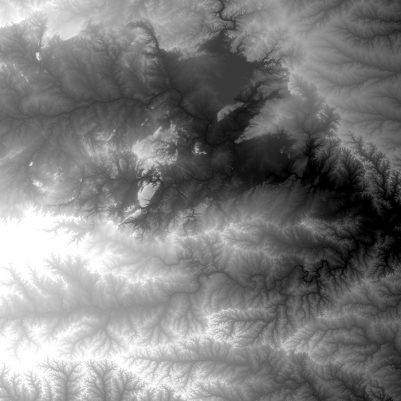
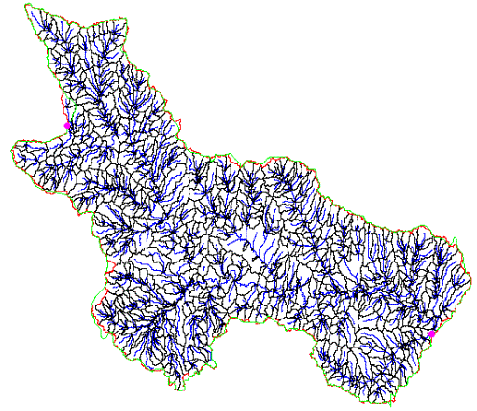
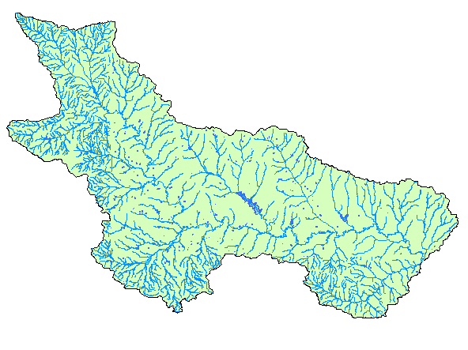
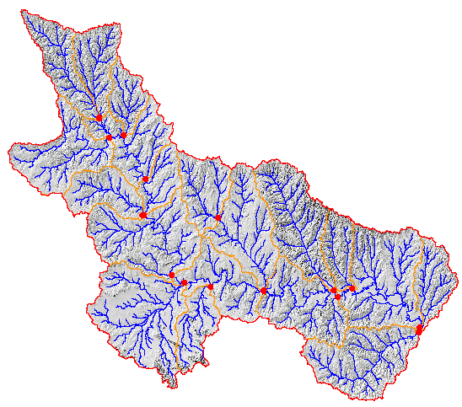
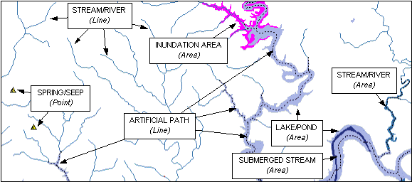
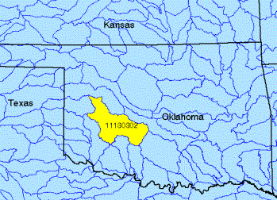
National Geospatial Datasets for Hydrology
By David G. Tarboton, Utah State University and David R. Maidment, University of Texas at Austin
Email: dtarb@cc.usu.edu
Web: http://www.engineering.usu.edu/dtarb
Email: maidment@mail.utexas.edu
Web: http://www.ce.utexas.edu/prof/maidment/
Absract
A series of national geospatial datasets for hydrology are being constructed by the federal government in collaboration with state partners. These include (1) the National Elevation Dataset, a seamless digital elevation surface of the United States now available with one arc-second (30m) cells, with one-third arc-second (10m) coverage in development; (2) the National Hydrography Dataset, a complete coverage of the river networks and water bodies of the United States at 1:100,000 scale, which is being improved to 1:24,000 scale in some states; (3) the Watershed Boundary Dataset in which a four level hierarchy of watersheds in the nation is being extended to a fifth and sixth levels through a combination of automated processing of DEM’s and hand digitizing; (4) the Elevation Derivatives for National Applications in which the National Elevation Dataset is being processed to define a very dense drainage network and fine resolution set of catchments. These datasets are the basis of a national geospatial data infrastructure for hydrology in the United States. Taken in combination with real-time water resources data from about 5000 USGS monitoring stations, these represent a powerful basis for studying hydrologic processes over various scales of space and time. We consider here the role these geospatial data sets have to play in an information system facility for the Consortium for the Advancement of Hydrologic Sciences.
Some trends in Hydrology
Emergence and growth of National Geospatial data structure on the internet
Extraordinary computational capability
Meaningful climate forecasts based on an understanding of global climate and weather systems
New statistics. Movement from a data poor to data rich paradigm. Exploratory data analysis and data mining. Non-parametric data based modeling and forecasting.
Emergence of hydrology as a geophysical science
Persistent mismatch between computational and observational effort in. Weakness in the observational basis for hydrologic science with prominent authors referring to hydrology as an "indoor sport".
National Elevation Dataset
(NED)
Elevation Derivatives for National Applications (EDNA)
Digital Elevation Model with 1 arc-second (30m) cells
Seamless in 1° blocks for the United States
10 billion data
Derived from USGS 1:24,000 quadrangle sheets
National program by USGS and NWS
5000 cell threshold on a 30m DEM (~ 8 km² average drainage area)
~ 1 million catchments for US when completed
Includes grid derived products e.g. Topmodel wetness index
http://edcnts12.cr.usgs.gov/ned/
http://edcnts12.cr.usgs.gov/ned-h/index.html
Watershed Boundary Dataset
Cooperative effort between the EPA and USGS
Combines EPA Reach File (RF3) and USGS Digital Line Graph (DLG) files to provide comprehensive 1:100,000 scale coverage of hydrography for the US.
Uniquely identifies and interconnects the stream segments or “reaches” that comprise the nation’s surface water drainage system.
Includes other common surface water bodies (e.g., lakes, reservoirs, estuaries, and coastlines).
National Program by USGS and USDA (NRCS)
Boundaries for 10- and 12- digit watersheds
First cut is by automated delineation from NED
Hand checked and edited
Provides a digital referencing system for the location of specific points on streams and coasts of the United States, allowing users to move along the reaches and encounter water-related entities in hydrological sequence as they move up or downstream.
http://nhd.usgs.gov/
http://www.ftw.nrcs.usda.gov/huc_data.html

Slide 2
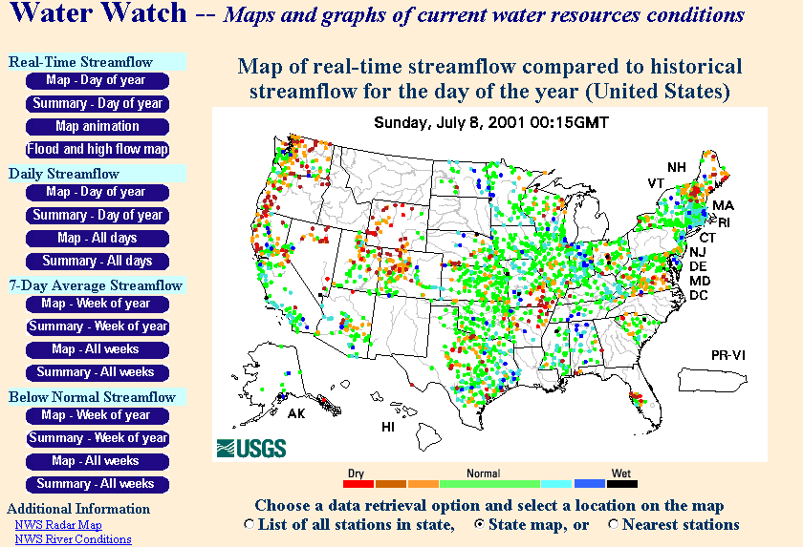
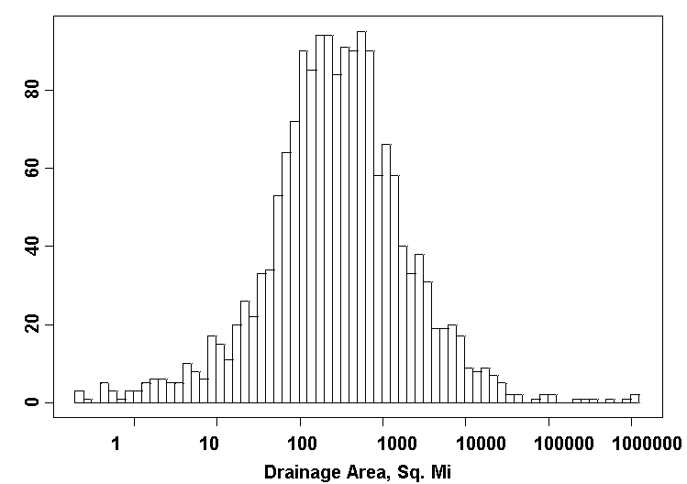
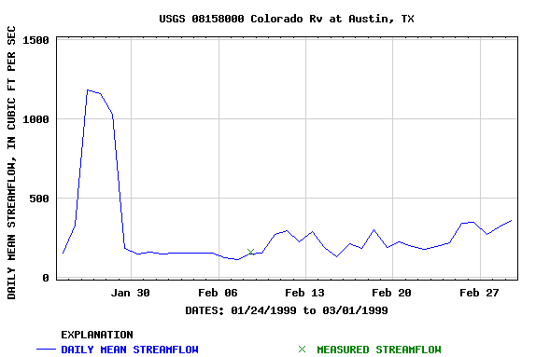
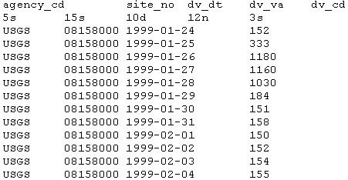
Suggestions for CUAHSI LTHO and Information Systems Initiatives
A National Observatory System as a Natural Laboratory
Develop the observational capability to quantify the complete hydrologic state at any point in time at a meaningful spatial scale.
Base this capability on a geospatial network of benchmark watersheds to provide the real time hydrologic pulse of the nation.
Include space based and in situ measurements.
Include a telecommunications and data dissemination system to disseminate data and products in real time.
Scale. Small enough to be manageable in terms of measurement and representative of a single relatively homogeneous physiographic setting. Large enough to integrate out fine scale varability. Suggest 10 km² or more.
Based on USGS Benchmark (HCDN plus others) watersheds.
Extend to quantify land use/land cover changes.
Complete physiographic characterization
Geographic placement and delineation
Topography
Land use and vegetation
Geology and soils
Relief
Hydrography
Complete measured water balance comprising
Streamflow (in and out in the case of reach watersheds)
Precipitation
Evapotranspiration
Groundwater outflow (inflow neglected – assume divide is also groundwater divide)
Soil moisture storage
Groundwater storage
Snow and ice storage
Water body storage
There must be a long term commitment to sustaining the system and maintaining the quality and stability of the measurements.
The Need (some ideas paraphrased from Burges, 2001 Langbein lecture http://jupiter.agu.org/webcast/burges.html)
As demand and competition for water increases, many water resource systems face narrower margins of error.
Trends towards over year storage patterns expose vulnerability to longer term climate processes (sustained droughts).
Important to understand and document the causes of streamflow variability.
Walter Langbein¹ championed the establishment of key gauging stations on natural streams “carefully operated with a view to maintaining consistent long-term records of streamflow as independent as possible from the influences of man”.
In a changing environment it is also important to have carefully operated long term gaging stations on developed watersheds to serve as reliable indicators of effects and trends due to the pervasive environmental changes occurring on our landscapes and in our watersheds.
Benefits
System to provide a snapshot of the hydrologic state of the nation at any point in time.
Empirical and large-scale modeling and watershed management will be enhanced through connection to physiographically similar "nearest neighbor" watersheds or through interpolation or regionalization of watershed measurements to other watersheds of interest.
Physical modeling and understanding will be improved through theory development and hypothesis testing based on the observatory watershed network.
An open, internet based National system will provide the ability to synthesize and integrate pattern and process at a spatial scale not seen before, stimulating fruitful curiosity driven inquiry into large scale hydrology.
Shortcomings of current system
Existing networks, although extensive are not coherently organized with data archival to consistent standards. Quantification of all processes involved in the hydrologic cycle involves multiple agencies and multiple data formats.
USGS streamflow
NASA remote sensing
NOAA weather stations and precipitation radar
USDA soils
There is no one stop shop for hydrologic information.
A national LTHO network and information system needs to provide a sound observational basis for new fundamental and applied hydrologic science
1. As quoted by Stephen Burges in 2001 Langbein lecture, http://jupiter.agu.org/webcast/burges.html)
USGS Hydro-Climatic Data Network (HCDN):
Streamflow Data Set, 1874-1988
USGS Water-Resources Investigations Report 93-4076 by
J. R. Slack, A. M. Lumb, and J. M. Landwehr
USGS National Water Information System
Web access to USGS water resources data
Real-time and Historic Data
Streamflow and stage
Groundwater levels
Water Quality
Site information
Tabular or Graphical Format
Incomplete because precipitation and other hydrologic cycle data is not included.
A dataset of 1659 streamflow sites throughout the US and its territories selected to be unaffected by artificial diversions, storage, or other works of man
Average record length 43 yr
Drainage area
Median 297 mi²
Average 4256 mi²
http://water.usgs.gov/pubs/wri/wri934076
http://water.usgs.gov/usa/nwis/

