Slide 1
The CUAHSI Community Hydrologic Information System
David Tarboton, David Maidment, Ilya Zaslavsky, Dan Ames, Jon Goodall, Richard Hooper, Jeffrey Horsburgh
CUAHSI
HIS
Sharing hydrologic data
http://his.cuahsi.org/
Support
EAR 0622374

Slide 2
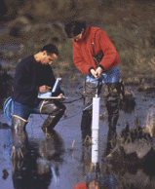
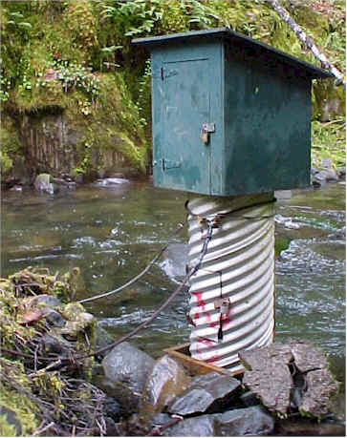
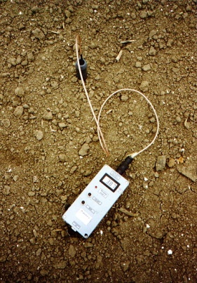
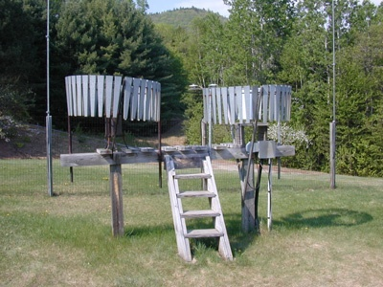
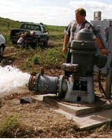
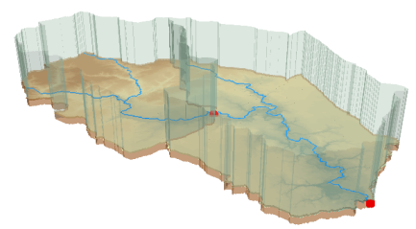
Hydrologic Data Challenges
Water quality
Water quantity
From dispersed federal agencies
From investigators collected for different purposes
Different formats
Points
Lines
Polygons
Fields
Time Series
Rainfall and Meteorology
Soil water
Data Heterogeneity
Groundwater
The way that data is organized can enhance or inhibit the analysis that can be done
GIS

Slide 3
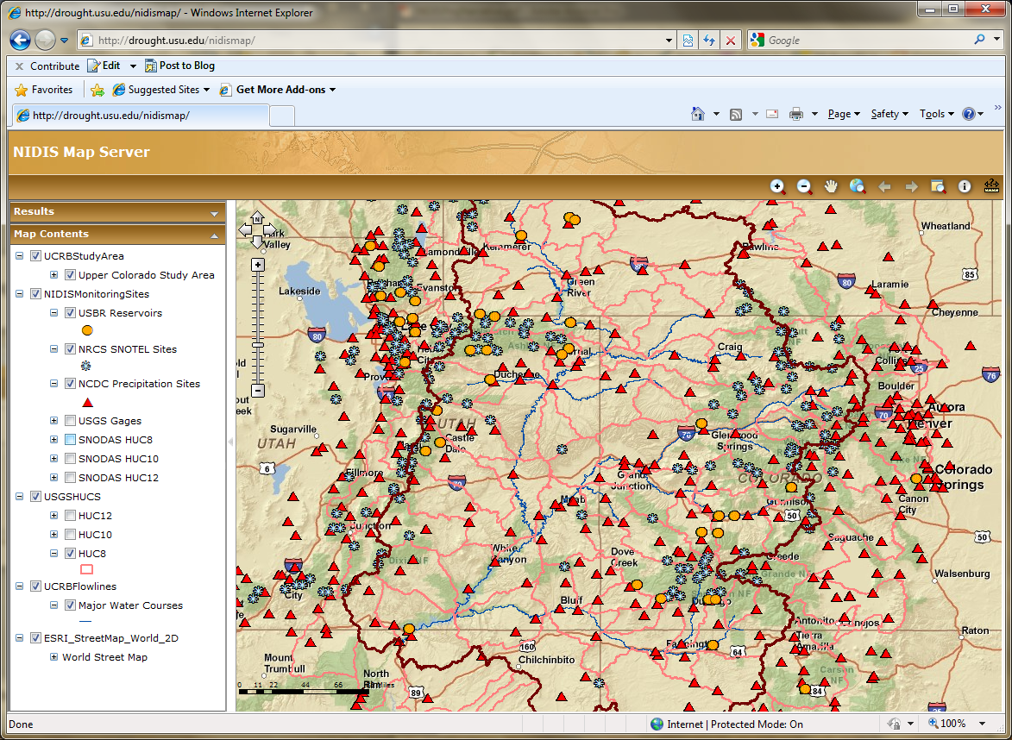
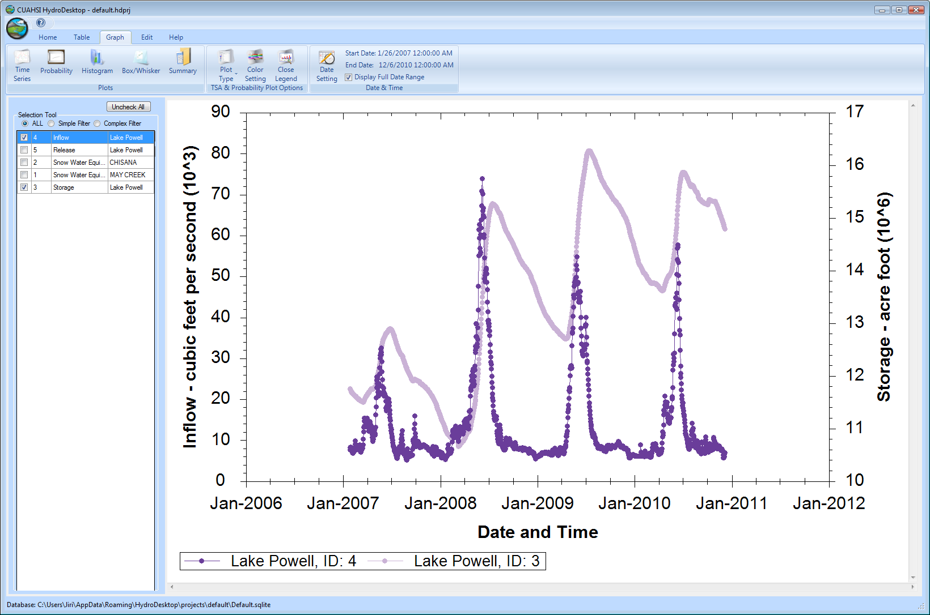
CUAHSI HIS
The CUAHSI Hydrologic Information System (HIS) is an internet based system to support the sharing of hydrologic data. It is comprised of hydrologic databases and servers connected through web services as well as software for data publication, discovery and access.
HydroServer – Data Publication
HydroCatalog
Data Discovery
Lake Powell Inflow and Storage
HydroDesktop – Data Access and Analysis
HydroDesktop – Combining multiple data sources

Slide 4
CUAHSI Hydrologic Information System Services-Oriented Architecture
Data Discovery and Integration
HydroCatalog
Metadata Services
WaterML, Other OGC Standards
Search Services
HydroServer
HydroDesktop
Data Publication
Data Services
Data Analysis and Synthesis
ODM
Geo Data
Information Model and Community Support Infrastructure

Slide 5
What are the basic attributes to be associated with each single data value and how can these best be organized?
DateTime
Interval (support)
“When”
Time, T
Units
Accuracy
Censoring
Qualifying comments
t
A data value
v_{i} (s,t)
Variable
Method
Quality Control Level
Sample Medium
Value Type
Data Type
Source/Organization
“Where”
s
Space, S
V_{i}
Location
Feature of interest
“What”
Variables, V

Slide 6
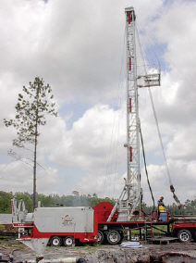
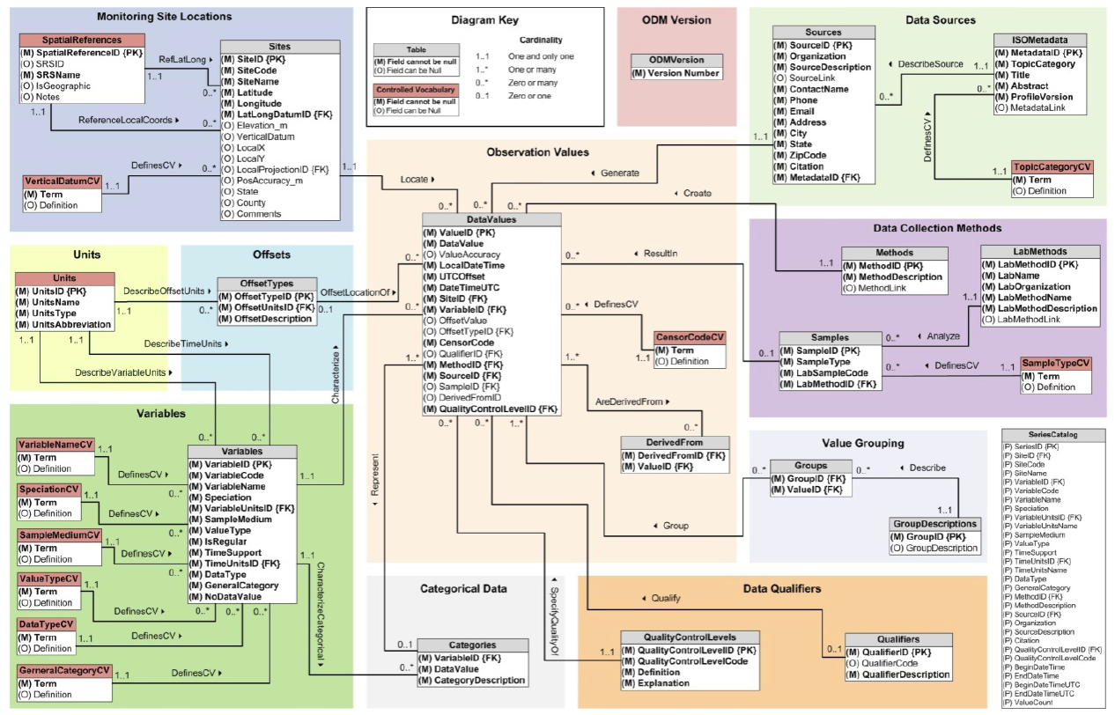
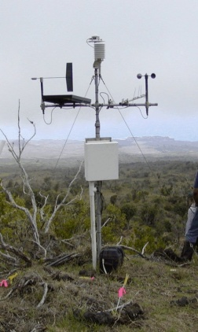
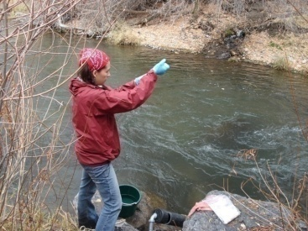
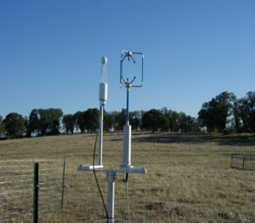
Observations Data Model (ODM)
Streamflow
Provides a common persistence model for data storage
Groundwater
levels
Precipitation
& Climate
Soil
moisture
data
Water Quality
Flux tower data
A relational database at the single observation level
Metadata for unambiguous interpretation
Traceable heritage from raw measurements to usable information
Promote syntactic and semantic consistency
Cross dimension retrieval and analysis
Horsburgh, J. S., D. G. Tarboton, D. R. Maidment, and I. Zaslavsky (2008), A relational model for environmental and water resources data, Water Resources Research, 44, W05406, doi:10.1029/2007WR006392.

Slide 7
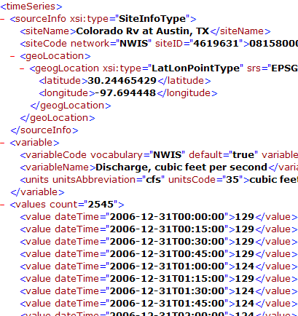
WaterML and WaterOneFlow
WaterML is an XML language for communicating water data
WaterOneFlow is a set of web services based on WaterML
Set of query functions
Returns data in WaterML
GetSites
GetSiteInfo
GetVariableInfo
GetValues
WaterOneFlow
Web Service
Notes:
7

Slide 8
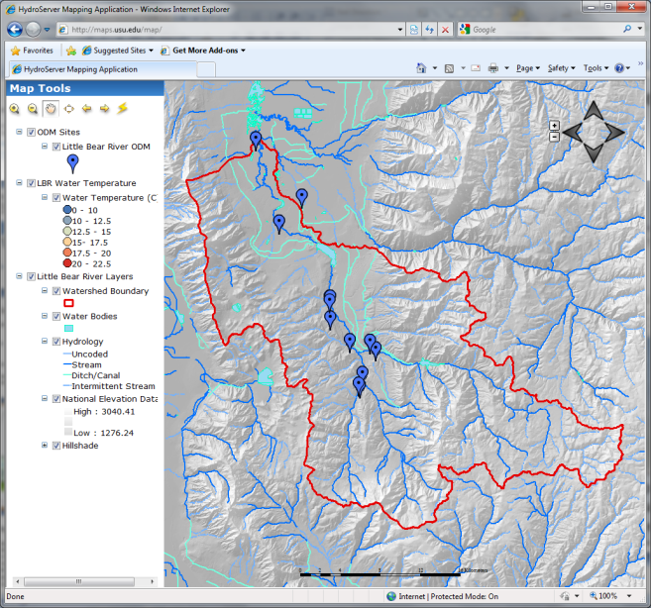
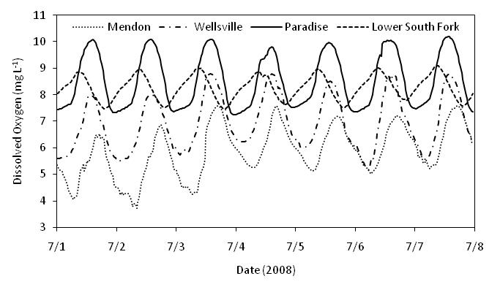
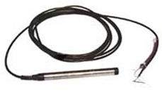
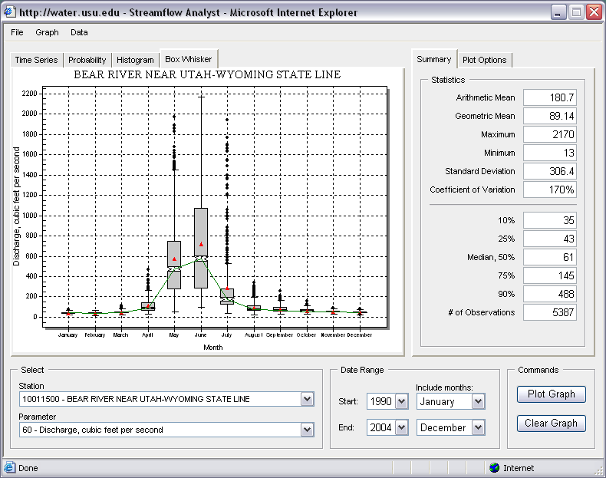
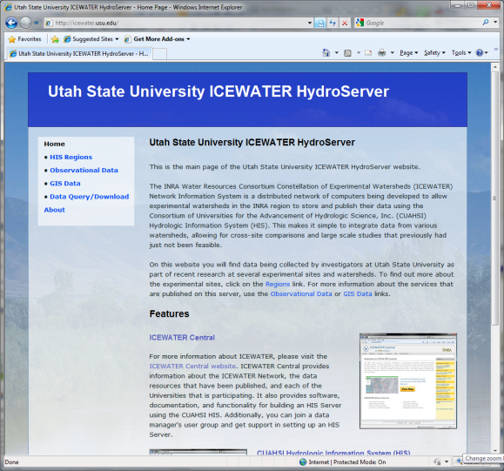
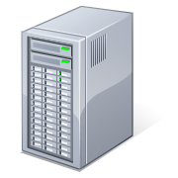
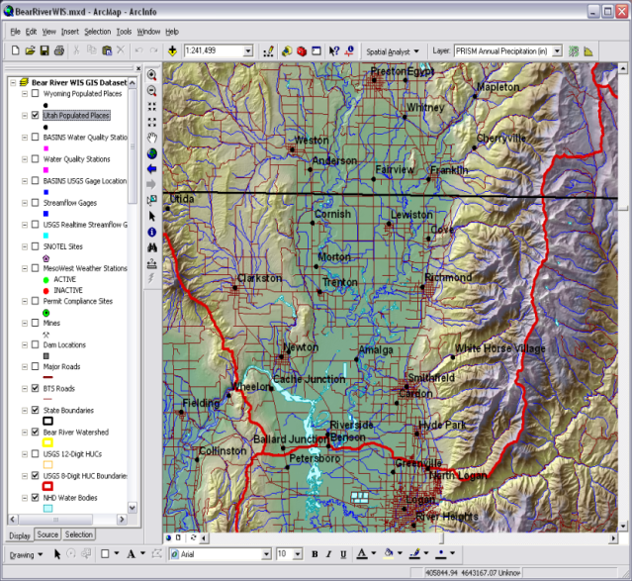
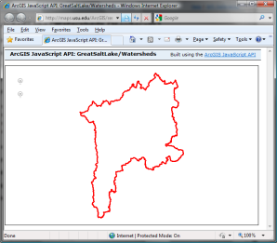
HydroServer – Data Publication
Point Observations Data
Internet Applications
Ongoing Data Collection
Historical Data Files
ODM Database
GetSites
GetSiteInfo
GetVariableInfo
GetValues
GIS Data
WaterML
WaterOneFlow
Web Service
OGC Spatial Data Service from ArcGIS Server
Data presentation, visualization, and analysis through Internet enabled applications
Notes:
A platform for publishing space-time hydrologic datasets that:
Autonomous with local control of data
Part of a distributed system that makes data universally available
Basis for Experimental Watershed or Observatory data management system
Standards based approach to data publication
Accepted and emerging standards for data storage and transfer (OGC, WaterML)
Built on established software
MS SQL Server, ArcGIS server
Open Source Community Code Repository
Sustainability

Slide 9
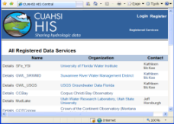
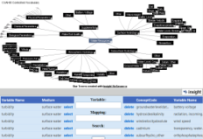
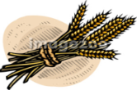
HydroCatalog
Service Registry
Hydrotagger
Search over data services from multiple sources
Supports concept based data discovery
WaterML
Harvester
Water Metadata Catalog
GetSites
GetSiteInfo
GetVariableInfo
GetValues
WaterOneFlow
Web Service
Search Services
CUAHSI Data Server
3rd Party Server
e.g. USGS
Discovery and Access
Hydro
Desktop
http://hiscentral.cuahsi.org

Slide 10
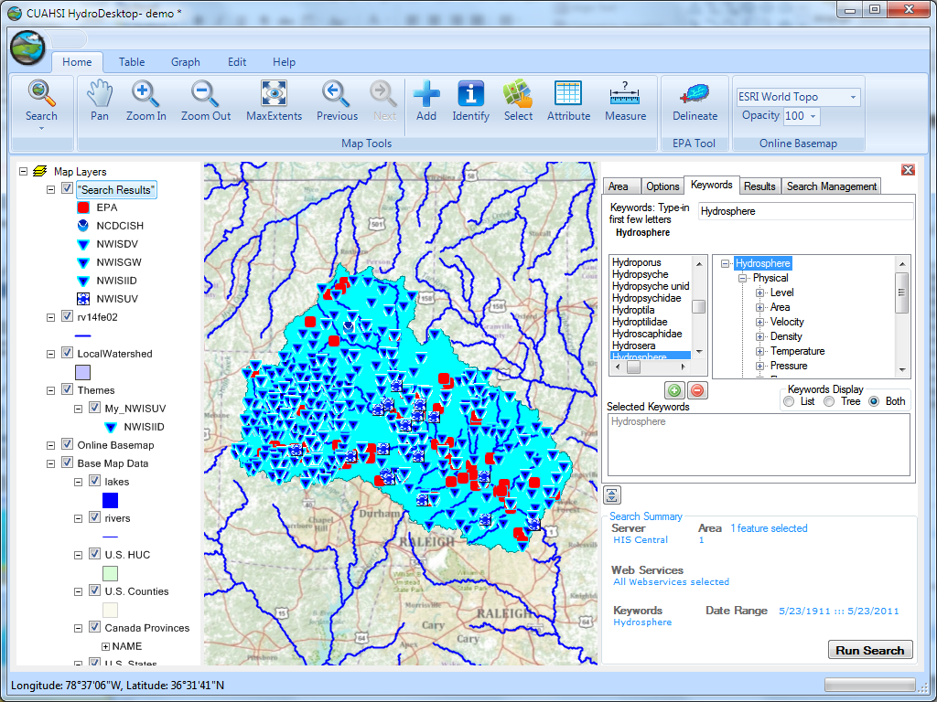
Thematic keyword search
HydroDesktop – Data Access and Analysis
Integration from multiple sources
Search on space and time domain

Slide 11
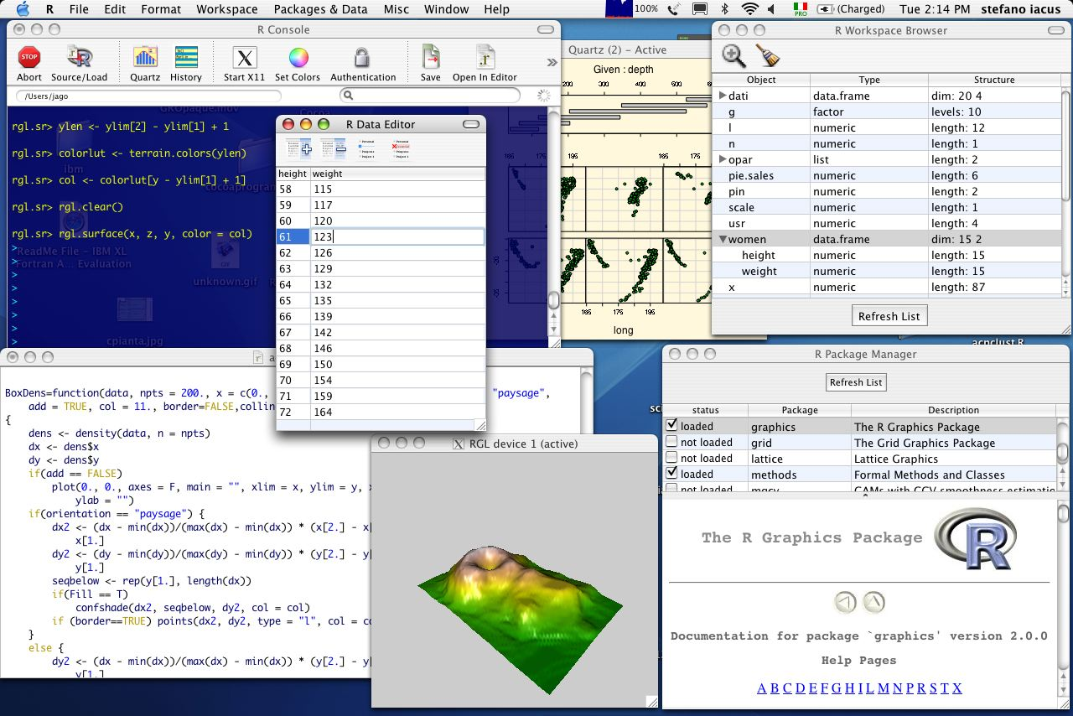
Integration with “R” Statistics Package

Slide 12
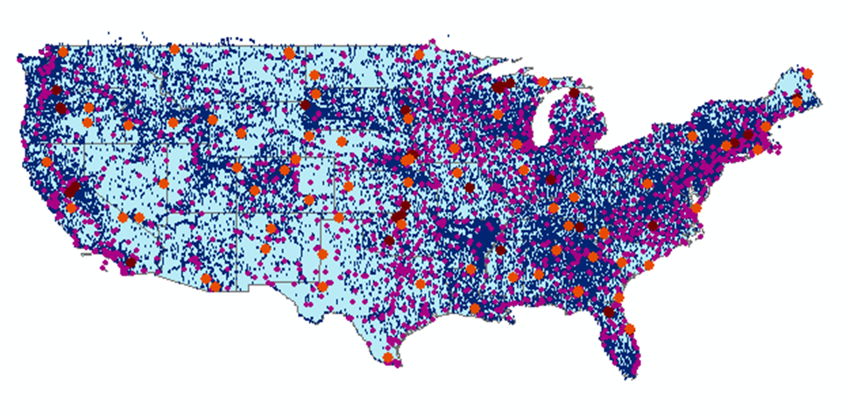
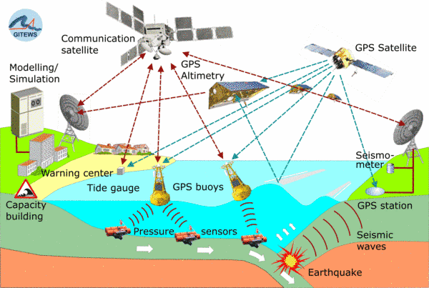
Open Geospatial Consortium Web Service Standards
These standards have been developed over the past 10 years ….
…. by 400 companies and agencies working within the OGC
Map Services
Web Map Service (WMS)
Web Feature Service (WFS)
Web Coverage Service (WCS)
Catalog Services for the Web (CS/W)
Observation Services
Observations and Measurements Model
Sensor Web Enablement (SWE)
Sensor Observation Service (SOS)
OGC Hydrology Domain Working Group evolving WaterML into an International Standard
http://www.opengeospatial.org/projects/groups/waterml2.0swg

Slide 13
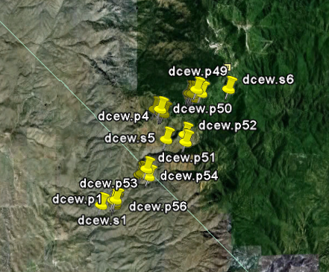
A growing collection of HydroServers and community of users
University of Maryland, Baltimore County
Montana State University
University of Texas at Austin
University of Iowa
Utah State University
University of Florida
University of New Mexico
University of Idaho
Boise State University
University of Texas at Arlington
University of California, San Diego
Idaho State University
Dry Creek Experimental Watershed (DCEW) (28 km² semi-arid steep topography, Boise Front)
68 Sites
24 Variables
4,700,000+ values
Published by Jim McNamara, Boise State University

Slide 14
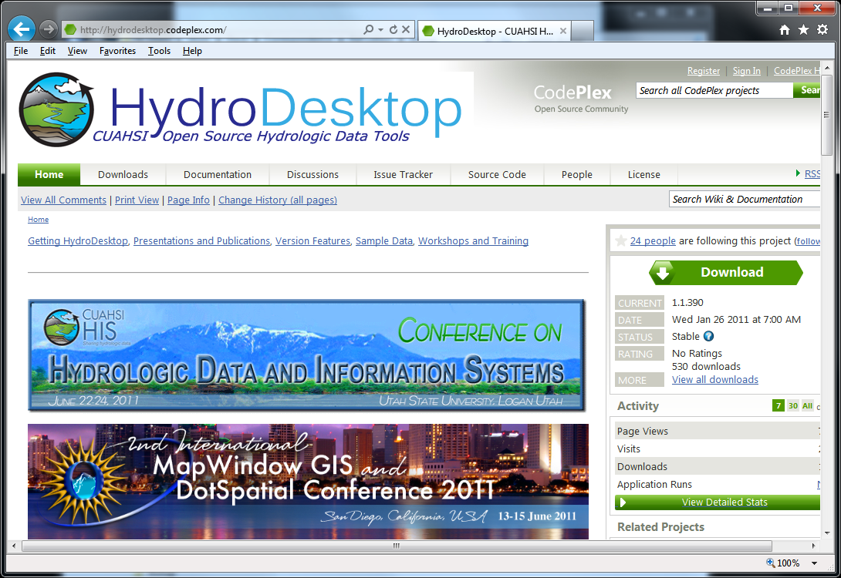
Open Development Model
http://hydrodesktop.codeplex.com
http://hydroserver.codeplex.com
http://hydrocatalog.codeplex.com

Slide 15
General aspects of the approach
Common functional components
Storage in a community data model
Publication from a server
Data access through internet-based services using consistent language and format
Tools for access and analysis
Discovery through thematic and geographic search functionality
Integrated modeling and analysis combining information from multiple sources
Discovery and Integration
Catalog
Discoverability
Metadata Services
Search Services
Standards
Server
Desktop/Client
Publication
Synthesis and Research
Data Services
Accessibility
Consumability
Information Model and Community Support Infrastructure

Slide 16
Looking to the Future
Move from prototype to operations
Operational support of software and systems
User support and training
Repositories
CUAHSI Data Center (User Support Specialist)
NSF Data Management Requirements
Research and development of new functionality
data and model sharing “hub” to enhance interactive collaboration (pending)
Community
HIS has become bigger than one project (emerging software ecosystem)
Open Development Model (inspire, enable and incorporate broad contributions)
The community is the infrastructure that persists (is sustainable)

Slide 17
Thanks! HIS Project Team and Sponsors
University of Texas at Austin – David Maidment, Tim Whiteaker, James Seppi, Fernando Salas, Jingqi Dong, Harish Sangireddy
San Diego Supercomputer Center – Ilya Zaslavsky, David Valentine, Tom Whitenack, Matt Rodriguez
Utah State University – Jeff Horsburgh, Kim Schreuders, Stephanie Reeder, Edward Wai Tsui, Ravichand Vegiraju, Ketan Patil
University of South Carolina – Jon Goodall, Anthony Castronova
Idaho State University – Dan Ames, Ted Dunsford, Jiří Kadlec, Yang Cao, Dinesh Grover
Drexel University/CUNY – Michael Piasecki
WATERS Network – Testbed Data Managers
CUAHSI Program Office – Rick Hooper, Yoori Choi, Conrad Matiuk
ESRI – Dean Djokic, Zichuan Ye
CUAHSI
HIS
Sharing hydrologic data
http://his.cuahsi.org/
Support
EAR 0622374

