Slide 1


Distributed Hydrologic Modeling using GIS and Topmodel
David G. Tarboton
Utah State University
Ross Woods, Charles Pearson, Ude Shankar, Roddy Henderson, Richard Ibbitt
National Institute of Water and Atmospheric Research, New Zealand

Slide 2
Objectives
Use distributed hydrologic modeling to improve understanding of the hydrology, water balance and streamflow variability in the Grey River basin.
  Test and validate model components and complete model against internal and spatially distributed measurements.
  Evaluate the level of complexity needed to provide adequate characterization of streamflow at various scales.
  Quantify spatial heterogeneity of inputs (rainfall, topography, soils - where data exist) and relate this to heterogeneity in streamflow.

Slide 3
Overview
The data used
  DEM based system for delimiting channels, model components and estimating model parameters
  Precipitation interpolation
The Model
  Enhanced TOPMODEL
    Soil Zone
    Interception
  Evapotranspiration
Results
  Small watershed calibration and validation
  Reconciliation of spatial pattern of rainfall with rain gage and streamflow measurements

Slide 4
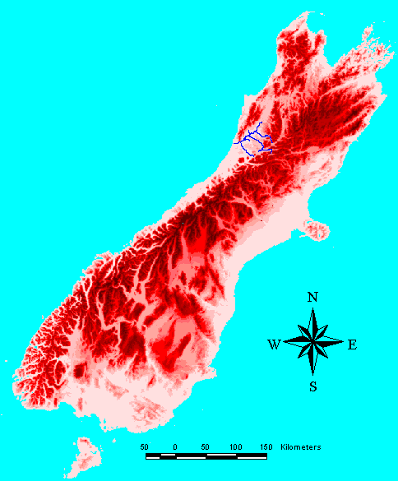
Location Map of the Grey River
New Zealand South Island
Basin Area: 3817 km²
Flow: 12.1 x 10⁹ m³
Flow/Area: 3184 mm
Greymouth
Christchurch

Slide 5
Grey Digital Elevation Model
2815 rows
3675 columns
30 m grid
Notes:
The source data is 20 m contours digitized from 1:50,000 scale topographic maps. This has been processed into a 30 m grid using TOPOGRID, the Arc/Info grid implementation of Hutchinson’s ANUDEM methods for gridding contour data while respecting topographic drainage features.
The Grey river is located on the West Coast of the South Island of New Zealand. The range to the NW is the Paparoa going up to 1400 m, with an extension of the Southern Alps to the south and east going up to 1950 m within the area shown. The presence of the central fault is clearly evident. The orography has a big influence on precipitation. Valley annual rainfall totals are 2 m or even lower in the rain shadow of the Paparoa’s. Mountain annual rainfall totals of 5m have been recorded, but gauges are sparse in the mountains.

Slide 6
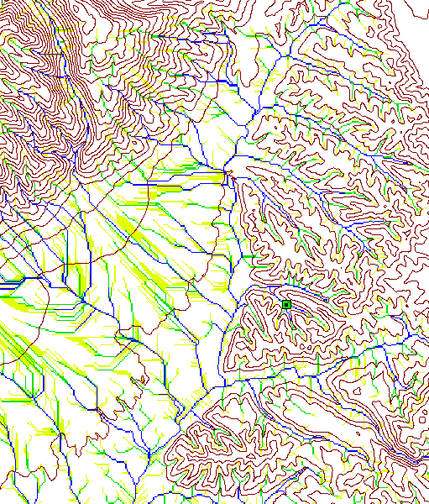
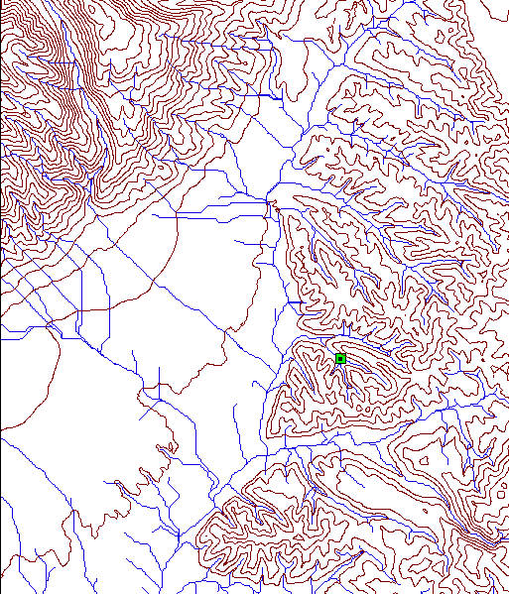
Channel Network Extraction
Contributing area
Channels defined using curvature threshold
Notes:
Automatic data preparation system for channel network and watershed delineation and setup of TOPMODEL inputs (a/tanβ).
Support area threshold channel network delineation is common.
Left panel shows 20, 100 and 500 grid cell thresholds.
In the past I have worked on objective determination of the threshold based upon:
Slope versus area plots that have a theoretical basis in terms of form stability theory
Analysis of network scaling properties (Horton slope law and constant stream drop property)
A support are threshold based method has the drawback of imposing a constant drainage density.
Here we used a method based upon the identification of upward curvature following a method given by Peuker and Douglas. In a contributing area type algorithm we accumulated the area from only upward curved grid cells and used a threshold on this determined from the the analysis of slope versus area plots and network scaling properties. I.e. it is a hybrid of approaches that has the ability to extract networks with varying drainage density.
The right panel shows the results, where we see streams extending up crenulated valleys with support area of 100 grid cells, whearas in the flat valley bottom areas 100 grid cell flow paths are not demarcated as streams.
This is visually and admittedly somewhat subjectively appealing.

Slide 7
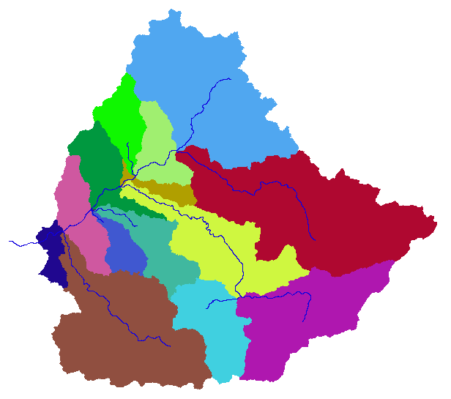
Order 5 subbasin delineation

Slide 8
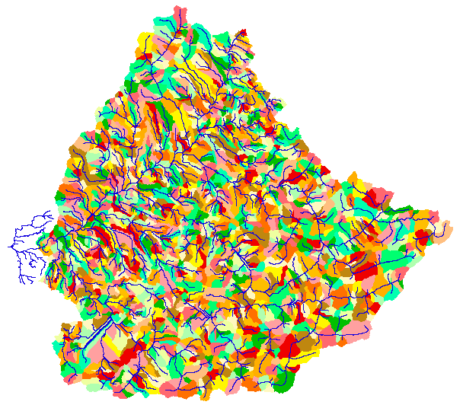
Order 2 subbasin delineation
Notes:
Here there are 1608 subbasins. It is possible to attribute different parameters to model elements and evaluate the sensitivity to modeling scale. With this many model elements it is essential to be able to automatically determine parameters based upon GIS information. The way I have topmodel currently dimensioned I can model only 215 subbasins before running out of memory, so this extreme case could not be modeled.

Slide 9
Vegetation

Slide 10
Depth Weighted
Macroporosity

Slide 11
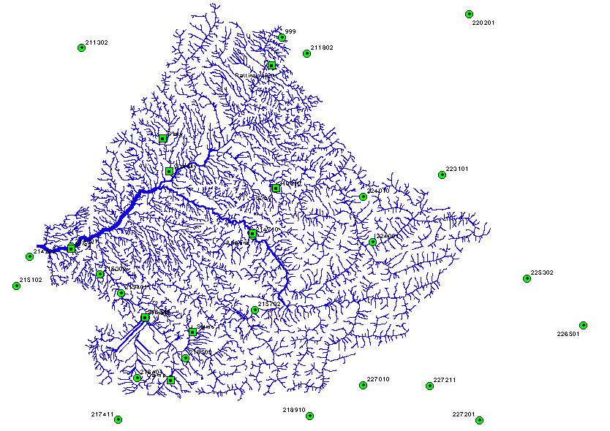
Rain and streamflow gauges
Notes:
25 Raingauges.
9 Water level streamflow recorders.
All data was aggregated/disaggregated to an hourly time step. For the precipitation gaps were filled in using correlation with nearby gauges and when the gauge was daily recording was disaggregated to hourly following the pattern at a nearby hourly recording gauge.

Slide 12
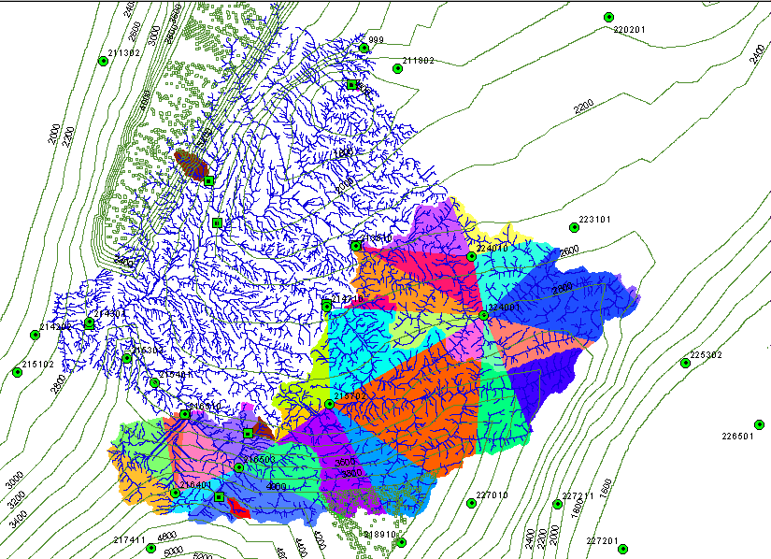
Rainfall
Notes:
Complicate slide, but bear with me as I explain it because rainfall estimation is a crucial problem here.
Circles show rain gauges.
The contours show the estimate of the mean annual rainfall surface that reflects the orographic effects. Digitized from one drawn by Al McKerchar based upon 30 years of NZ Met Service rainfall normals. These were interpolated onto a grid to provide an annual rainfall estimate at each grid element.
Wanted to model the spatial pattern of rainfall over the watershed, recognizing orographic variability and using the gauges present.
Need precipitation at each point as a weighted average of precipitation from nearby weights. Used a scheme to determine weights based upon Delauney triangles, linear interpolation and normalization by annual rainfall estimate.

Slide 13
Rainfall interpolation
A(x) - Normal annual rainfall at location x
P_{i} - Hourly precipitation at gauge location x_{i}
P(x) - Hourly precipition at (non gauge) location x.
N_{i} = P_{i}/A(x_{i}) - Normalized hourly precipitation at gauge i.
Weight or basis function for linear interpolation of normalized precipitation at location x from gauges at nodes of the encompassing Delauney triangle
P(x) = N(x) A(x) - Precipitation estimate for location x.
Over subbasin

Slide 14
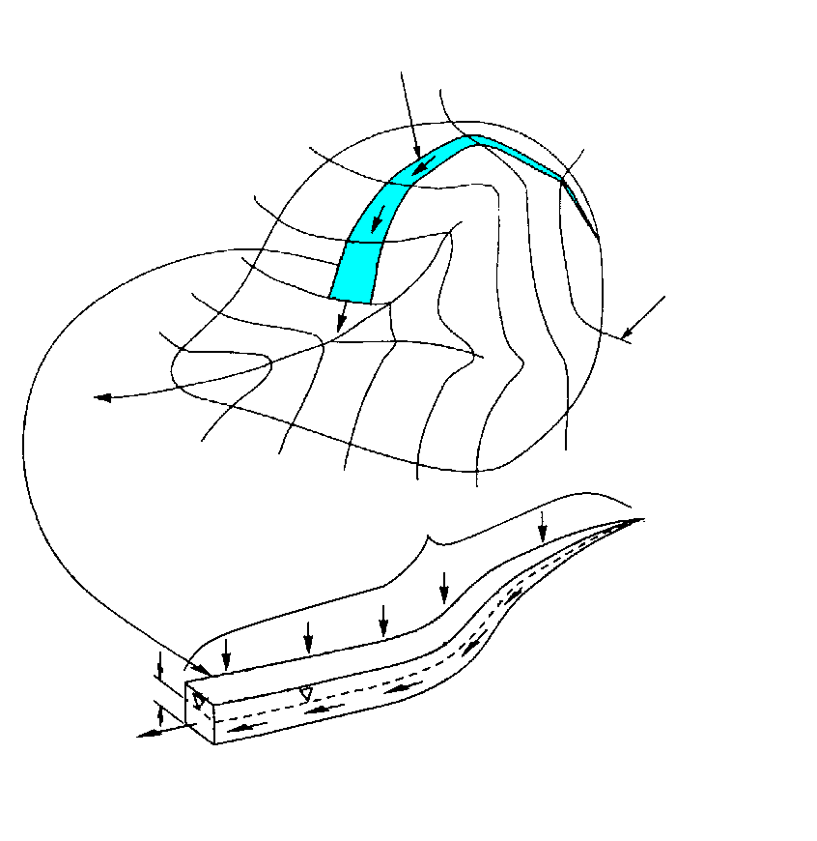
Hydrologic Model
Stream line
TOPMODEL (Beven and Kirkby, 1979 and later) applied to each subwatershed.
Temperature and radiation based potential (reference) evapotranspiration.
Vegetation based interception component.
Modified soil zone
  Adjust ET based on soil moisture availability in root zone
  Infiltration excess runoff generation capabiity
  unsaturated storage and drainage
Parameters scaled by GIS average properties over each subwatershed.
Kinematic wave routing of streamflow through channel network.
Contour line
Upslope contributing area a

Slide 15
Topmodel (Based on Beven and Kirkby, 1979 and later)
Assumption 1.
Hydraulic conductivity decreasing with depth - sensitivity parameter f
Assumption 2.
Saturated lateral flow driven by topographic gradient and controlled by depth to water table (soil moisture deficit).
Assumption 3.
Steady state. Saturated lateral flow related to equilibrium recharge rate.
Determines depth to water table and
saturation excess runoff generation
when z < 0

Slide 16
Implementation (additions/modifications)

Slide 17
Potential Evapotranspiration (following Maidment D. R. (editor), 1993, Handbook of Hydrology, Chapter 4 on Evaporation by W J Shuttleworth.)
A = Available energy = (1-α)T_{f} S_{o} - f ε’ σ T⁴
f = T_{f}/a Cloudiness factor
Δ = gradient of saturated vapor pressure - temperature curve at air temperature
γ = psychometric constant at air temperature and pressure
ε’ = net emmissivity based upon dew point
Temperature and dew point lapsed from measurements at sea level
Notes:
Could reduce PET for non growing season

Slide 18
Model potential evapotranspiration compared to reference values for Reefton from Rowe, L. K., A. J. Pearce and C. L. O'Loughlin, (1994), "hydrology and Related Changes After Harvesting Native Forest Catchments and Establishing Pinus Radiata Plantations. Part 1. Introduction to the Study," Hydrological Processes, 8: 263-279.

Slide 19
Interception (adapted following Ibbitt, 1971)
1
Throughfall f(CV)
1
Relative intercepted storage CV/CC

Slide 20
Soil Zone
ET/PET
1
Green-Ampt like infiltration
excess rate formulation
Plant
Available
Drainable
z_{r}
Δθ₁
Δθ₂
Soil Drainage
SOILC = z_{r} (Δθ₁+ Δθ₂)
Drainage/Recharge r

Slide 21
Pattinson Creek

Slide 22
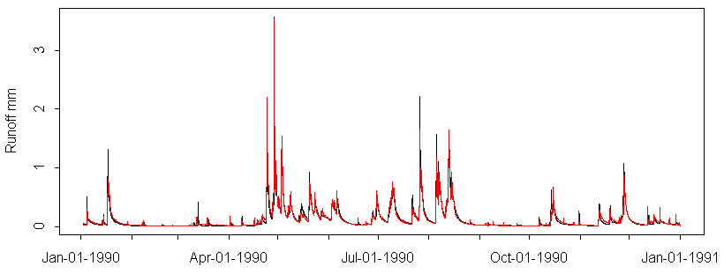
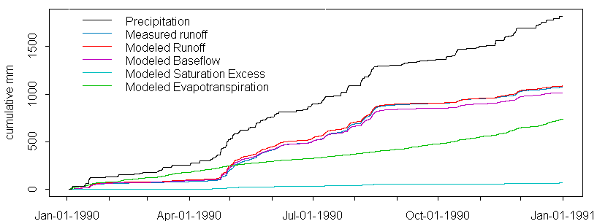
Pattinson Creek - Calibration 1990

Slide 23
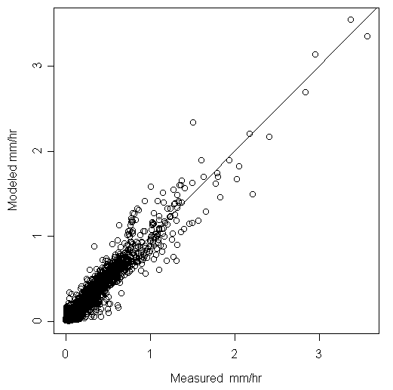
Pattinson Creek - Calibration 1990
Mean Square Error: 0.00264
Mean Absolute Error: 0.0252
Nash-Sutcliffe: 0.942

Slide 24
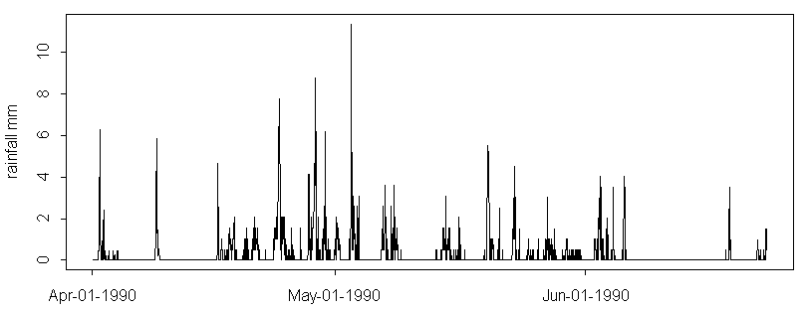
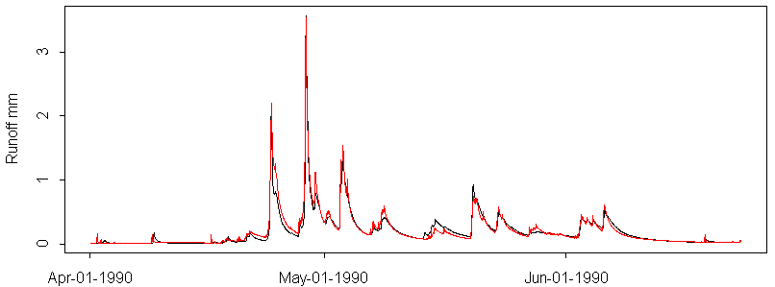
Pattinson Creek

Slide 25
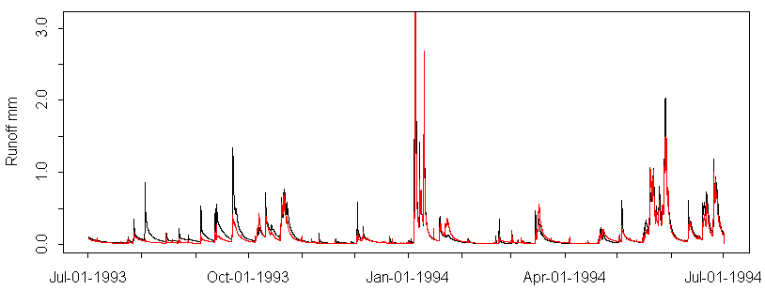
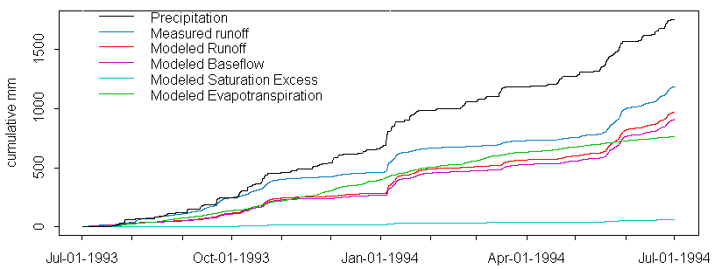
Pattinson Creek - Validation 1993/94 with triangulated rainfall

Slide 26
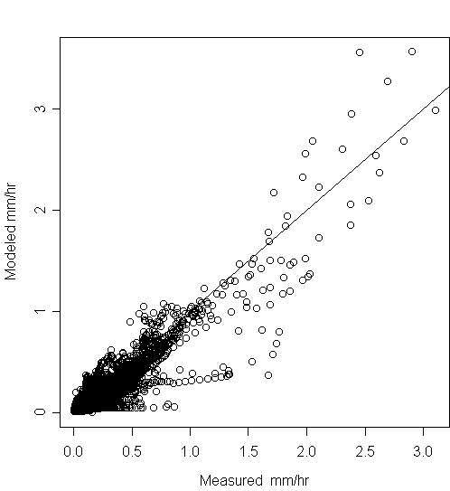
Pattinson Creek - Verification 1993
Mean Square Error: 0.00792
Mean Absolute Error: 0.043
Nash-Sutcliffe: 0.856

Slide 27
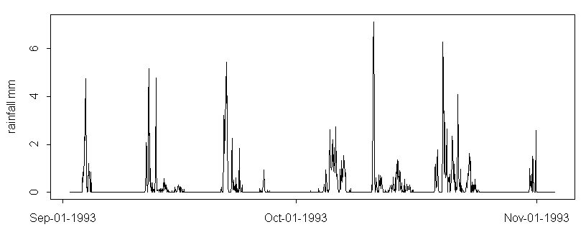
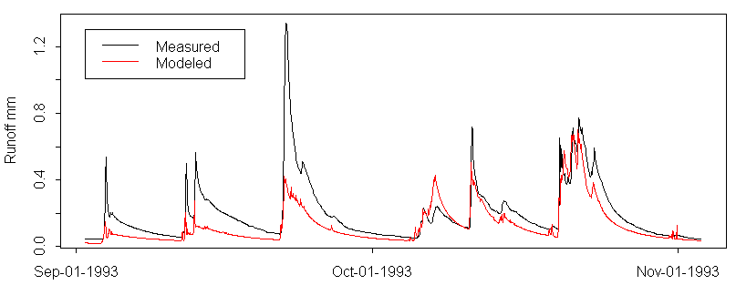
Pattinson Creek - 1993

Slide 28
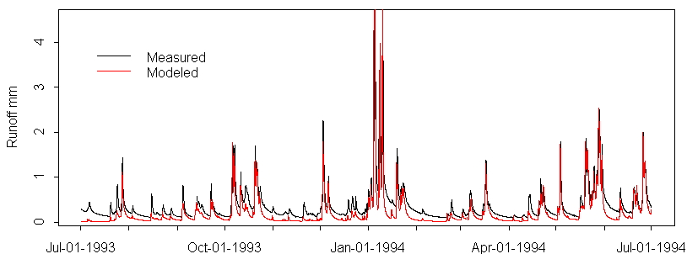
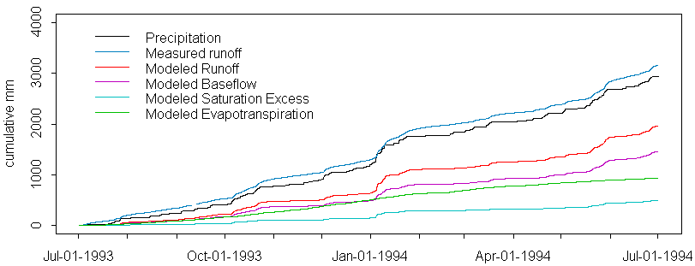
Grey at Dobson

Slide 29
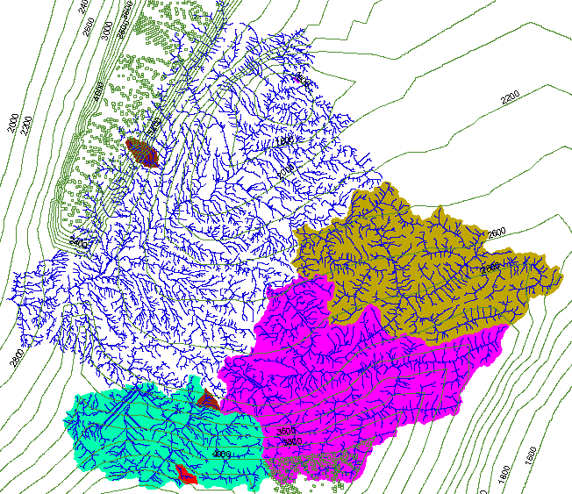
“White space” is the Grey at Dobson minus Ahaura, Arnold and Grey at Waipuna

Slide 30
Rainfall (lack of simple) dependence on elevation

Slide 31
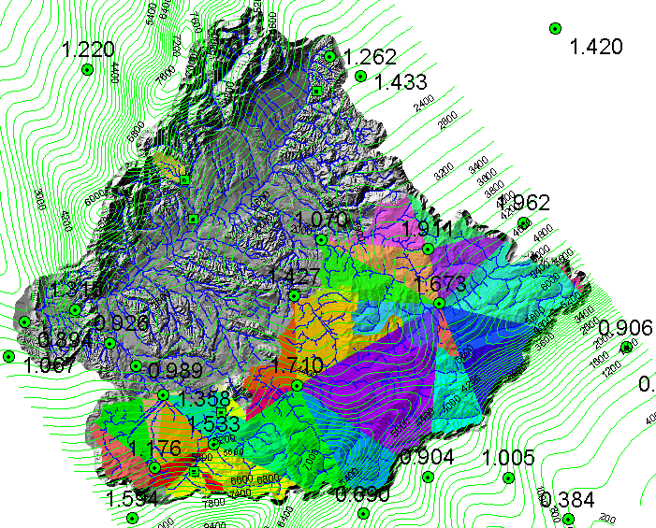
Rainfall interpolation and adjustment
Notes:
Complicate slide, but bear with me as I explain it because rainfall estimation is a crucial problem here.
Circles show rain gauges.
The contours show the estimate of the mean annual rainfall surface that reflects the orographic effects. Digitized from one drawn by Al McKerchar based upon 30 years of NZ Met Service rainfall normals. These were interpolated onto a grid to provide an annual rainfall estimate at each grid element.
Wanted to model the spatial pattern of rainfall over the watershed, recognizing orographic variability and using the gauges present.
Need precipitation at each point as a weighted average of precipitation from nearby weights. Used a scheme to determine weights based upon Delauney triangles, linear interpolation and normalization by annual rainfall estimate.

Slide 32
Rainfall interpolation

Slide 33
Parameters
Spatially variable
Spatially constant
Hydraulic conductivity K, calibrated using multiplying factor applied to spatially variable values.
The soil capacity parameter ‘soilc’ is estimated as (soil zone depth)/(dth1+dth2)

Slide 34
Basin average precipitation
Streamflow at outlet
Cumulative
water balance

Slide 35
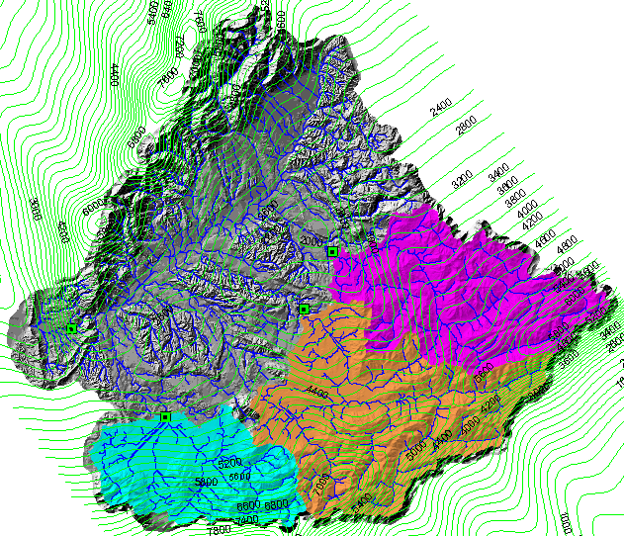
“White space” is the Grey at Dobson minus Ahaura, Arnold and Grey at Waipuna

Slide 36
Summary and Conclusions
Modeling system centered on TOPMODEL for representation of spatially distributed water balance based upon topography and GIS data (vegetation and soils).
Capability to automatically set up and run at different model element scales.
Encouraged by small scale calibration, though physical interpretation of calibrated parameters is problematic.
Large scale water balance problem due to difficulty relating precipitation to topography had to be resolved using rather empirical adjustment method.
Results provide hourly simulations of streamflow over the entire watershed.

Slide 37
Are there any questions ?
AREA 2
3
AREA 1
12

