Slide 1
Testing a Blowing Snow Model Against Distributed Snow Measurements at Upper Sheep Creek
Rajiv Prasad (Utah State University)
David G. Tarboton (Utah State University)
Glen E. Liston ( Colorado State University)
Charles H. Luce (USDA Forest Service)
Mark S. Seyfried (USDA Agricultural Research Service)

Slide 2
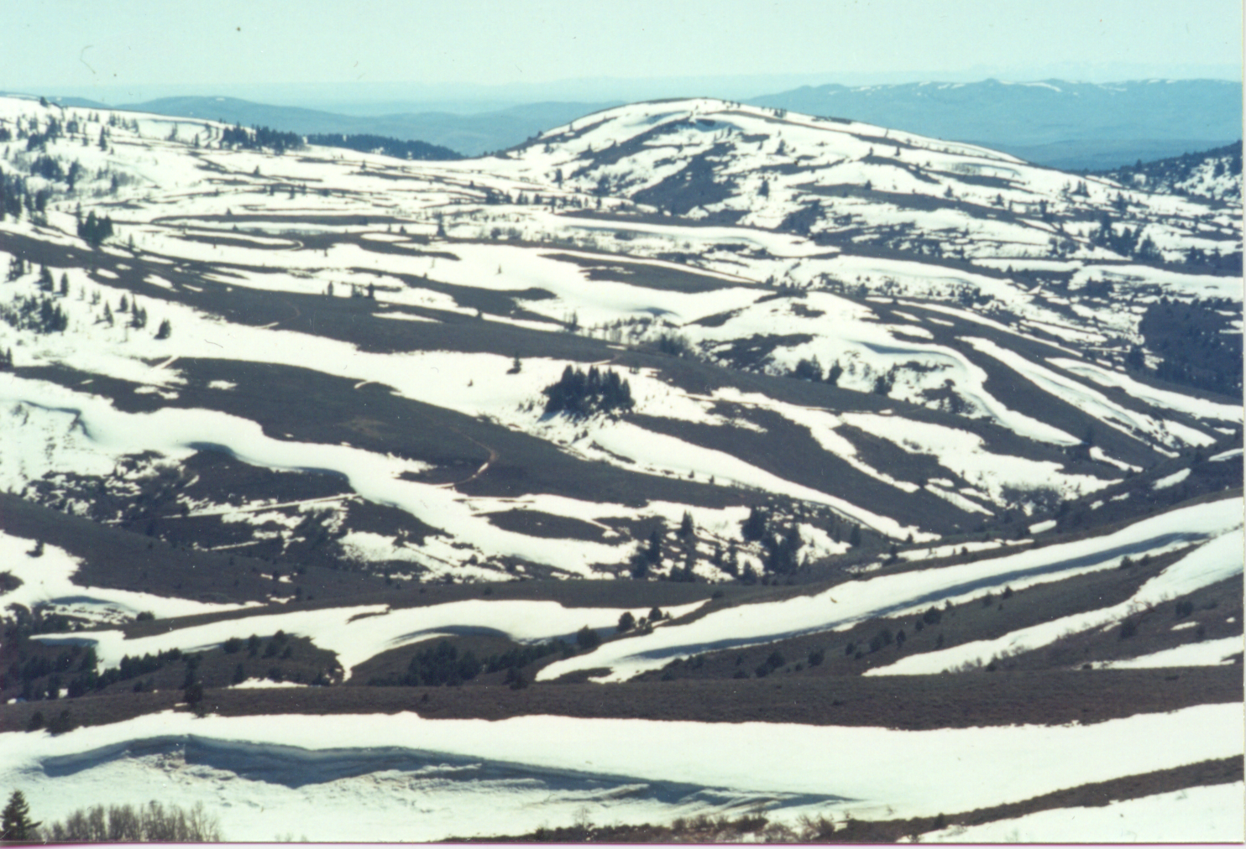

Slide 3
Objectives
Evaluate the blowing snow model SnowTran-3D against measurements
Evaluate the sensitivity to model inputs
Evaluate linearity. Can the spatial distribution of snow be parameterized in terms of drift factors?

Slide 4
Comparison Methods
Pointwise comparisons
Visual comparison of spatial maps
Basinwide averages
Zonal averages
Distribution functions

Slide 5
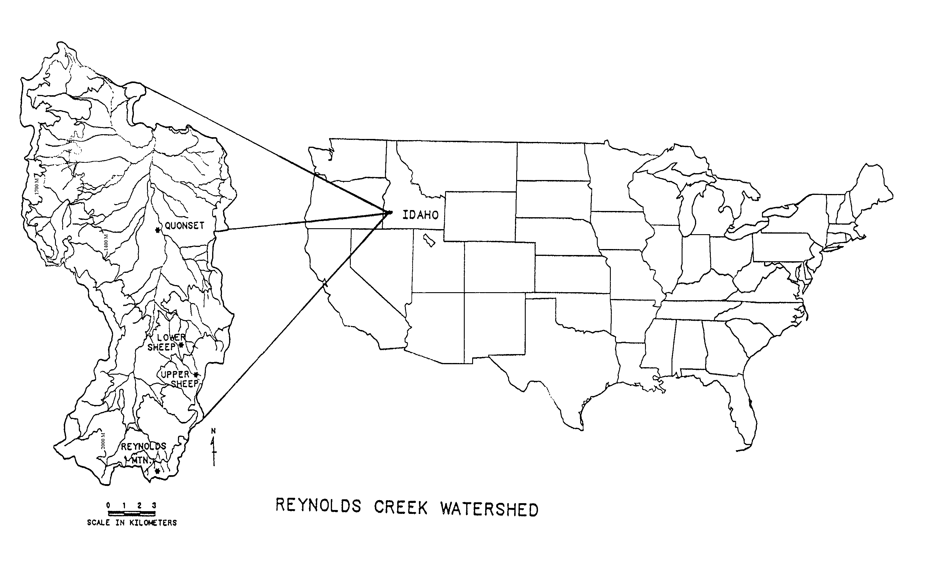
Reynolds Creek

Slide 6
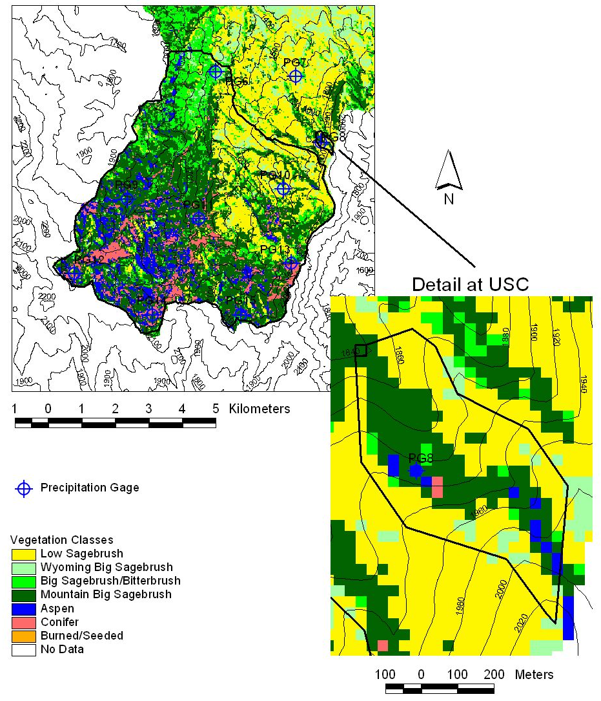
Tollgate SnowTran-3D study area
Area 165 km²
Elevation 1298 - 2258 m
Cumulative Precipitation during Oct. 1, 1992 through Mar. 23, 1993

Slide 7
Observed SWE

Slide 8
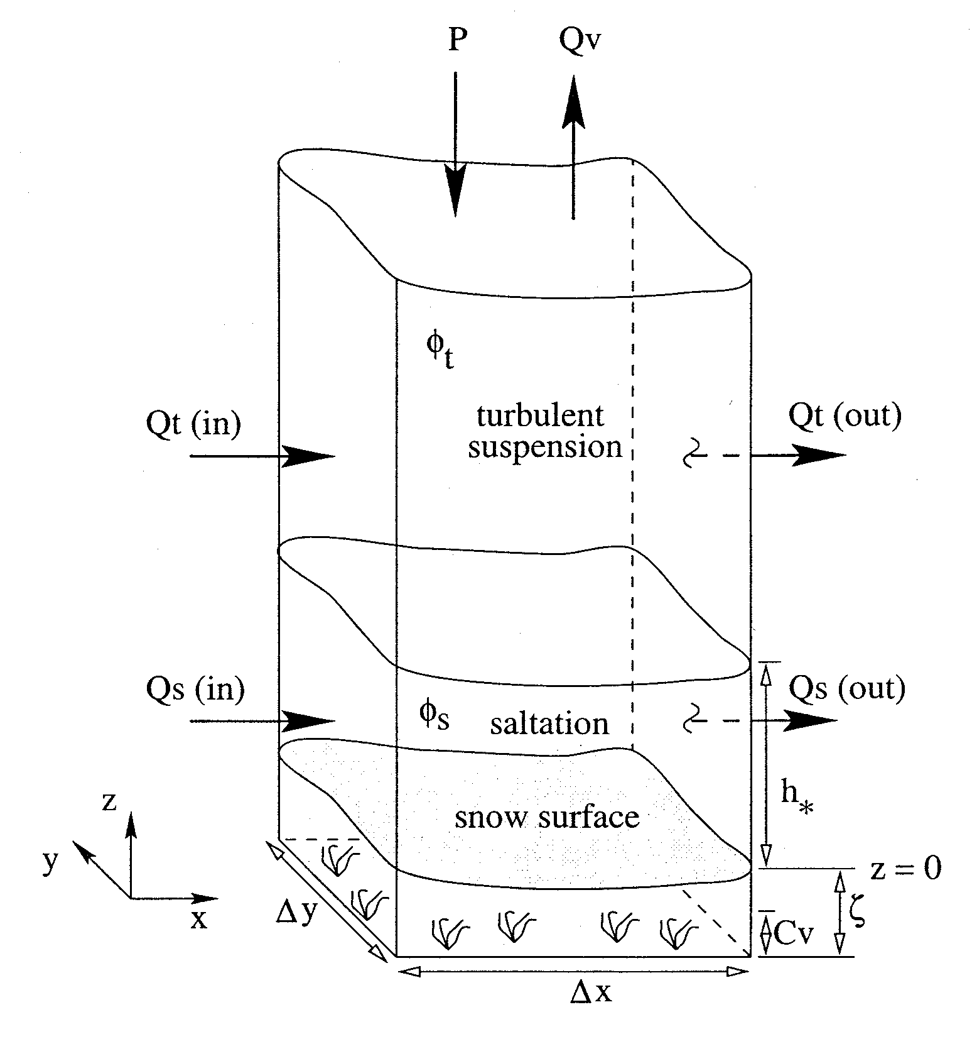
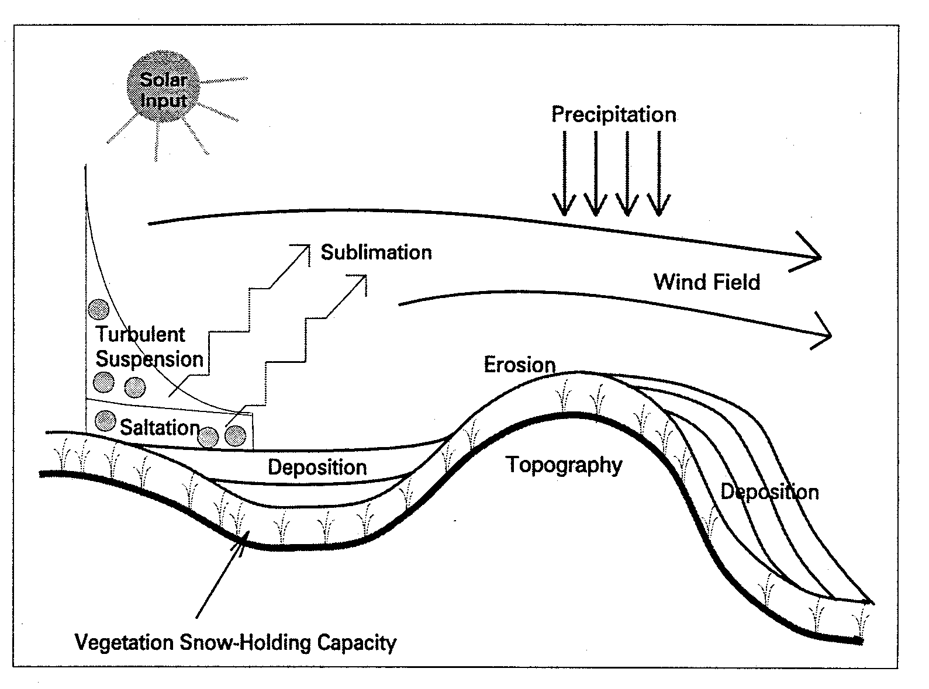
SnowTran-3D
Liston, G. E. and M. Sturm, (1998), "A Snow-Transport Model for Complex Terrain," Journal of Glaciology, 44(148): 498-516.
Inputs
DEM
Vegetation (Roughness, Snow holding capacity)
Weather (Air Temperature, Wind speed and direction, Precipitation)
Outputs
Snow depth
SWE (based upon assumed density)

Slide 9
Scenario’s Modeled
No vegetation information
LANDSAT vegetation
Upper Sheep Creek Precipitation
PG12 Precipitation

Slide 10
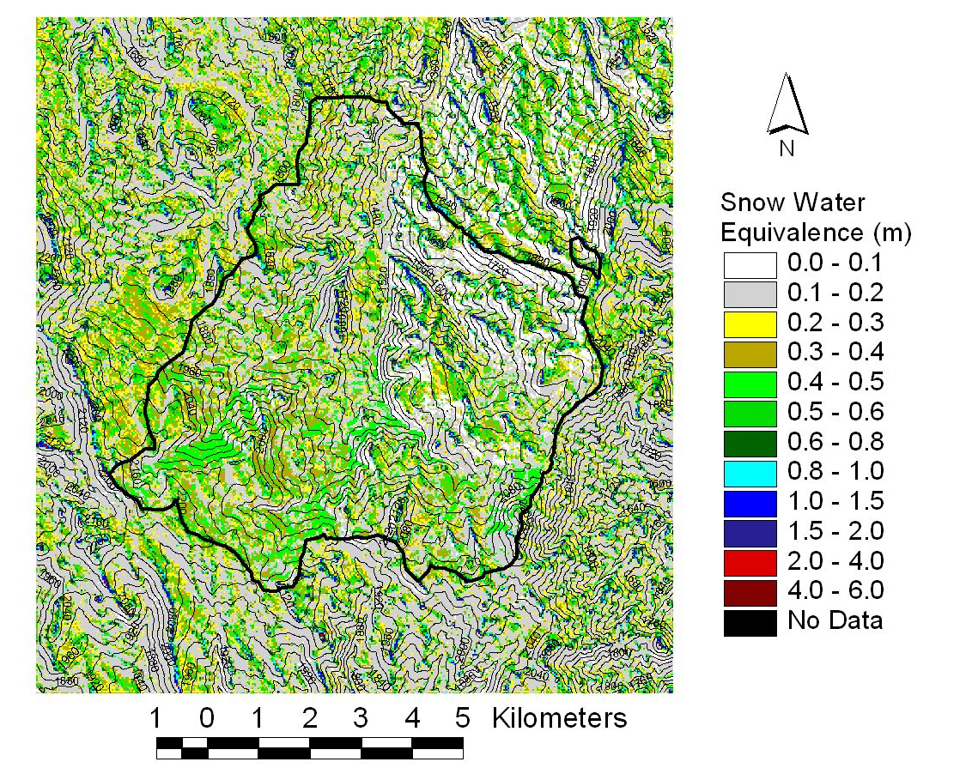
Full SnowTran-3D simulation
Upper Sheep Creek Precipitation
LANDSAT vegetation

Slide 11
Point Comparison

Slide 12
Visual comparison

Slide 14
Upper Sheep Creek Average Snow Water Equivalence

Slide 15
3/3/93 Upper Sheep Creek SWE analysis by zones
The deposition zone is defined as where net accumulation is more than snowfall. The scour zone is where net accumulation is less than snowfall

Slide 16
Drift factor approach that assumes linearity

Slide 19
Evaluation of wind model derived drift factors, Upper Sheep Creek, 3/3/1993.
Relative error comparison

Slide 20
Conclusions
Basinwide and zonal snow accumulation are reproduced.
Pointwise snow accumulation in error, though distributions are comparable.
Snow held in vegetation zone sensitive to vegetation parameters, though vegetation does not have a big impact on drift factor accuracy.
Drift factor estimated from blowing snow model still explains 75% of variability when precipitation is doubled.

Slide 21
Acknowledgements
We are grateful for financial support from the Environmental Protection Agency (agreement no. R824784) under the National Science Foundation/Environmental Protection Agency Water and Watersheds program, and NASA Land Surface Hydrology program (grant number NAG 5-7597). The views and conclusions expressed are those of the authors and should not be interpreted as necessarily representing the official policies, either expresses or implied, of the US Government. We are also grateful to Keith Cooley and others at the Northwest Watershed Research Center for use of the Upper Sheep Creek Snow Data.

